Slide 1
Basic Chemistry for Biology

Slide 2
Vocabulary
Proton
Neutron
Electron
Valence Electron
Bohr Model
Main Group Elements (A Groups)
Transition Metals (B Groups)
Lewis Dot Model
Covalent Bond
Polar Covalent Bond

Slide 3
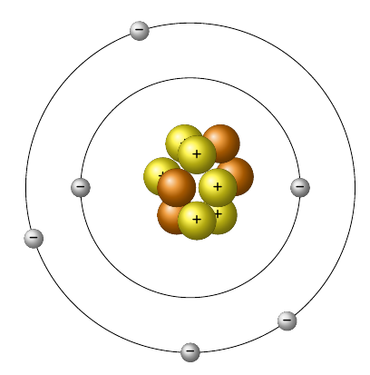
Bohr Atomic Model (Niels Bohr, 1913)
In 1913, Niels Bohr theorizes that atoms are mostly empty space.
Negative electrons do not just randomly orbit the positive nucleus, they move in dedicated layers.

Slide 4
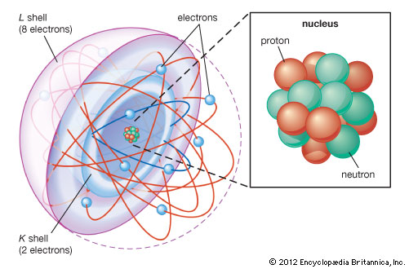
Subatomics
Atoms are made of 3 sub atomic particles
Nucleus region:
Proton (+)
Neutron (no charge)
Orbital regions:
3) Electrons (-) → e⁻

Slide 5
Octet Rule
Main-group elements (A Group elements: 1,2, 13-18) are most stable when their outermost shell of electrons is “full”
Due to the mobile nature of electrons, we claim that atoms are stable with 8 electrons in their outer shell. (Inner shells fill past 8 sometimes)
(Hydrogen and Helium are special in that they have 2 electrons in their outer shell)
This is called the Octet Rule.

Slide 6
Valence Electrons
The electrons in the outermost shell are called valence electrons.

Slide 7
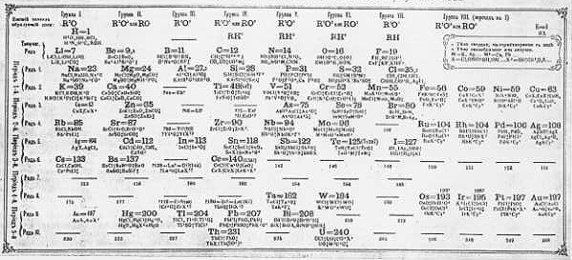
Early Periodic Table
In 1869, Russian chemist Dimitri Mendeleev starts the development of periodic table by organizing elements according to atomic mass.

Slide 8
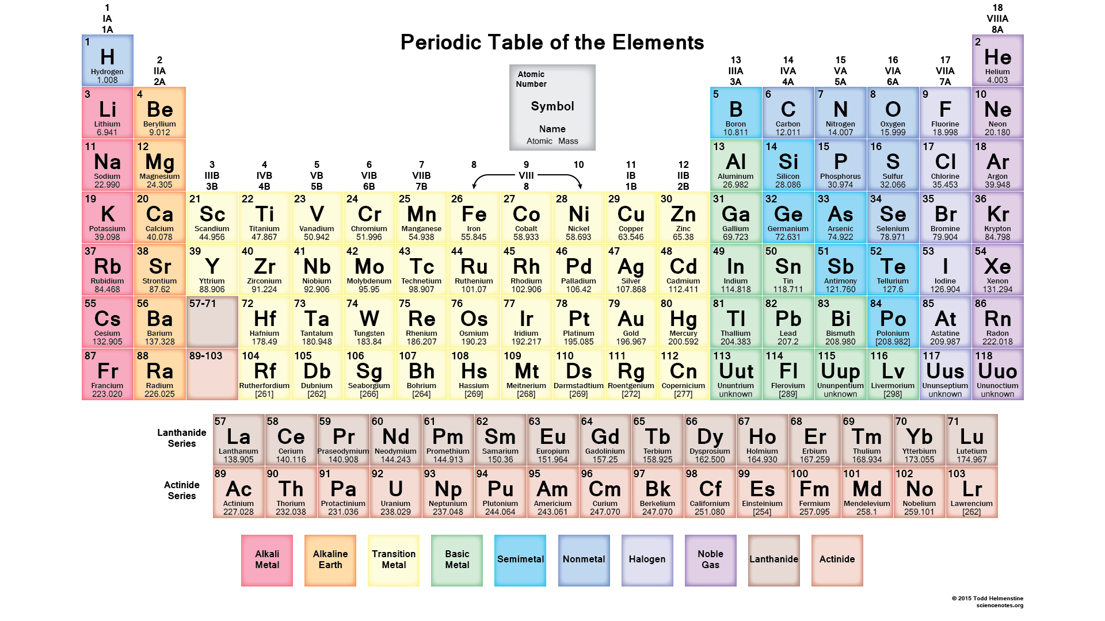
Modern Periodic Table
Arranged into Periods (horizontal rows) and Groups (vertical columns)

Slide 9
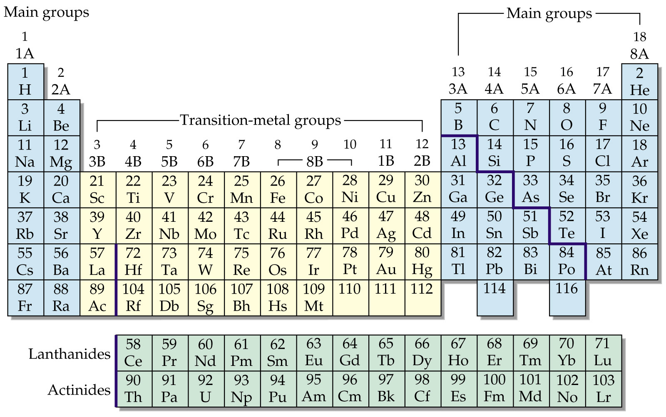
Main Group Elements
Groups 1, 2 and 13-18 are the main group elements.
They follow the Octet rule.

Slide 10
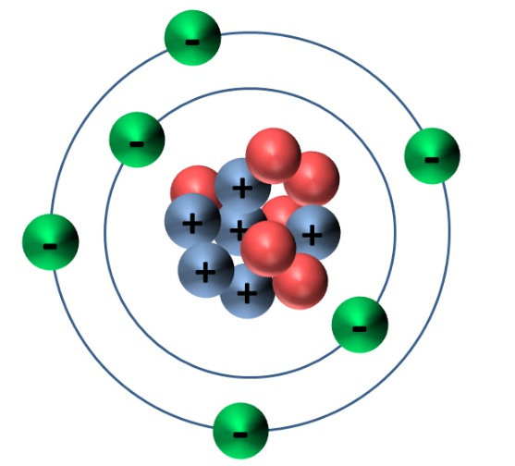
Lewis Dot Model
Only valence electrons are involved in bonding, so inner electrons are typically ignored (since their shells are full)
Replace the protons and neutrons in the nucleus with the atom’s symbol:
Ignore all of the inner shells
C
C

Slide 11
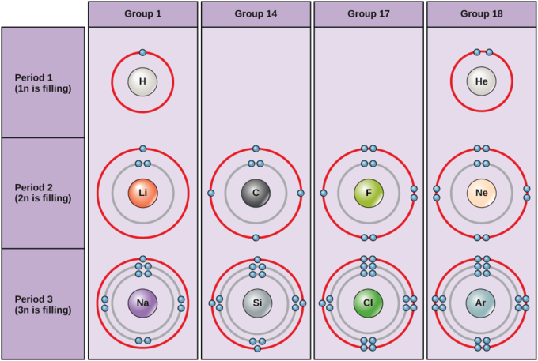
Lewis Dot and the Periodic Table
Since valence electrons are the only important electrons for bonding, let’s compare a few.
Look at Hydrogen, Lithium and Sodium
How about carbon and silicon?

Slide 12
Lewis Dot Practice
What does the Lewis Dot arrangement for oxygen look like?
What does the Lewis Dot arrangement for Nitrogen look like?
N

Slide 13
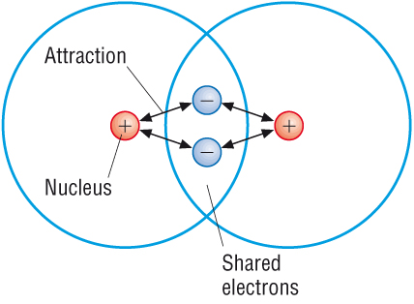
Covalent Bonds
A covalent bond is a sharing of two valence electrons between to atoms.
Any time a line is drawn between two atom’s symbols it means a covalent bond exists O H

Slide 14
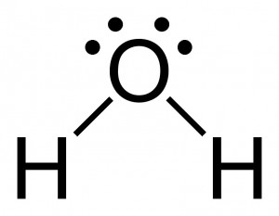
Making Molecules with the Octet Rule
Every element in groups 1, 2 and 13 – 17 want to be like the inert gases in group 18.
Oxygen wants to have 8 valence electrons (it has 6) Hydrogen wants to have 2 valence electrons (it has 1)

Slide 15
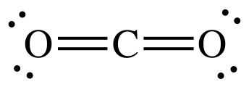
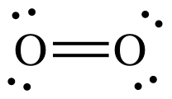
Double Covalent Bonds
If atoms share more than one covalent bond, it is called a double covalent bond.
You draw this with two lines. (Try drawing the Lewis Dot set up)
Carbon dioxide Oxygen gas

