Slide 1
DNA Structure and Discovery

Slide 2
TEKS
(6) Science concepts. The student knows the mechanisms of genetics, including the role of nucleic acids and the principles of Mendelian Genetics. The student is expected to:
(A) identify components of DNA, and describe how information for specifying the traits of an organism is carried in the DNA;
(B) recognize that components that make up the genetic code are common to all organisms

Slide 3
Vocabulary
Nucleic Acid
Nucleotide
Base pairing
Complementary
Template Strand
Semiconservative

Slide 4
Prerequisite Questions
What are the monomer molecules that make up nucleic acids?
What are the 3 structures of a nucleotide?
What is the purpose of DNA?

Slide 5
Essential Question #1
How was DNA determined to be the hereditary molecule?

Slide 6
History of DNA
70 years ago, DNA was a mystery to most scientists
Scientists knew of its existence, but not of its purpose.
The following slides are just some of the major experiments that helped to define the role of DNA in biology

Slide 7
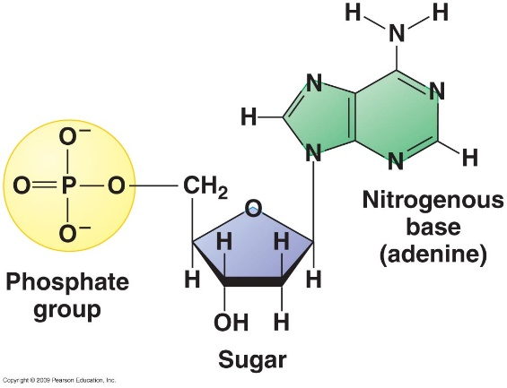
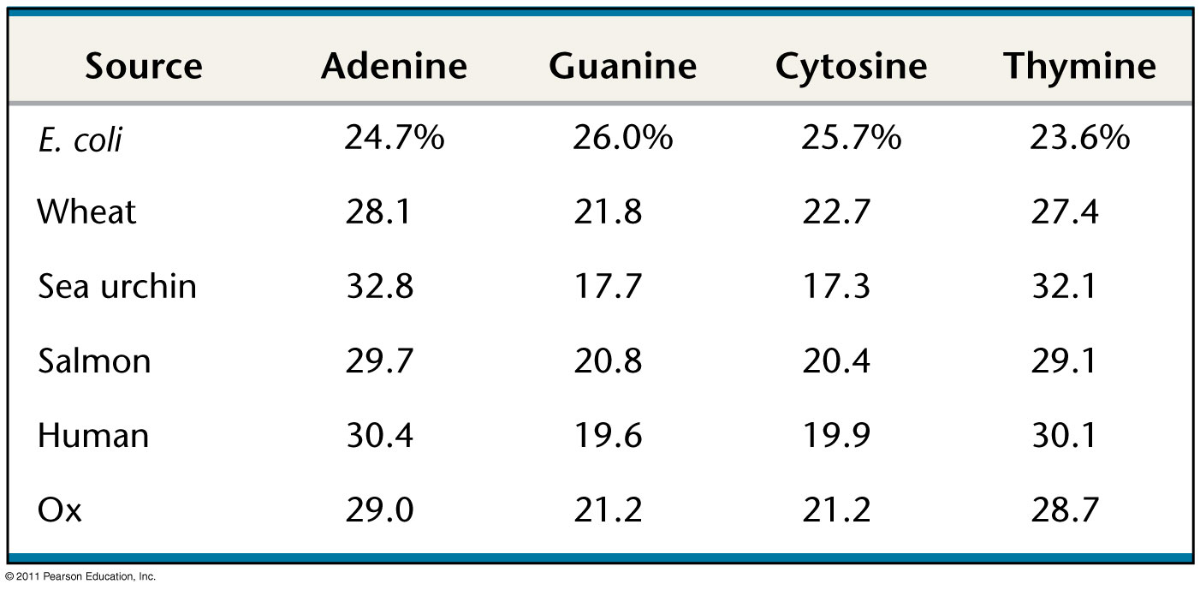
Erwin Chargaff (1950)
Common knowledge that nucleotides consist of phosphate group, a sugar and a nitrogenous base.
Compared composition of the 4 bases between many different organisms.

Slide 8
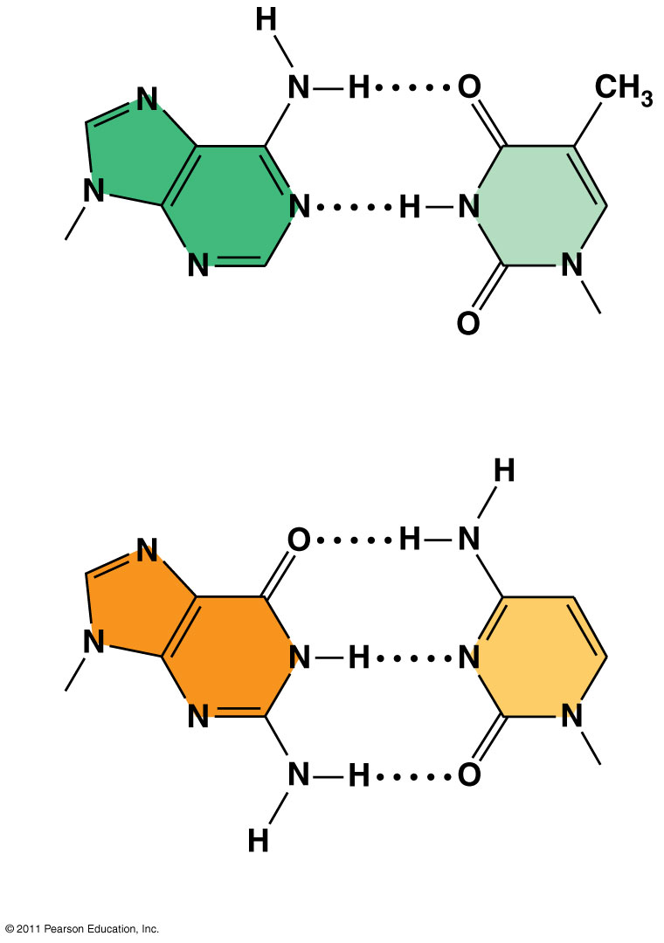
Erwin Chargaff (1950)
Stated what we know today as Chargaff’s Rules.
Only certain bases pair up.
Adenine pairs with Thymine
Guanine pairs with Cytosine.
Sugar
Sugar
Adenine (A)
Thymine (T)
Sugar
Sugar
Guanine (G)
Cytosine (C)

Slide 9
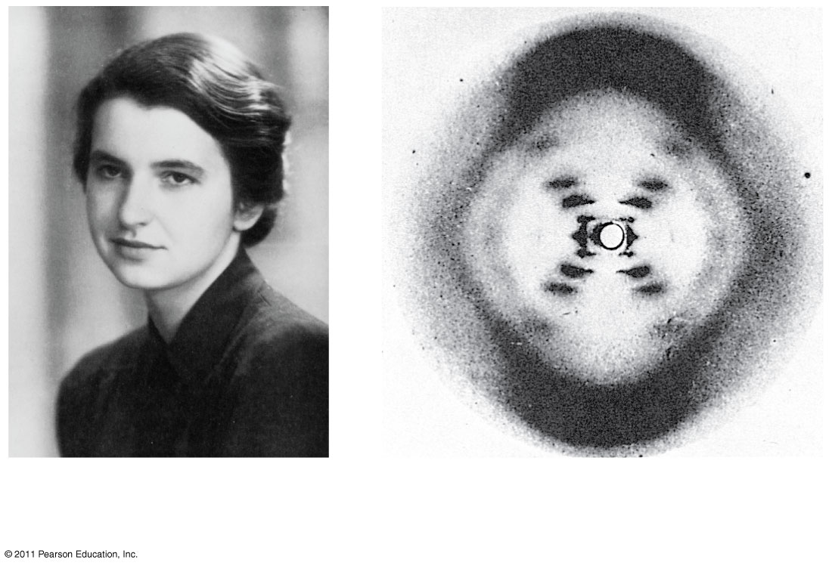
Rosalind Franklin (1952)
Used an X-ray technique to photograph DNA
Saw that DNA had:
2 spiraling components
Fixed width
Alternating “rung” pattern
(a) Rosalind Franklin
(b)
Franklin’s X-ray diffraction photograph of DNA

Slide 10
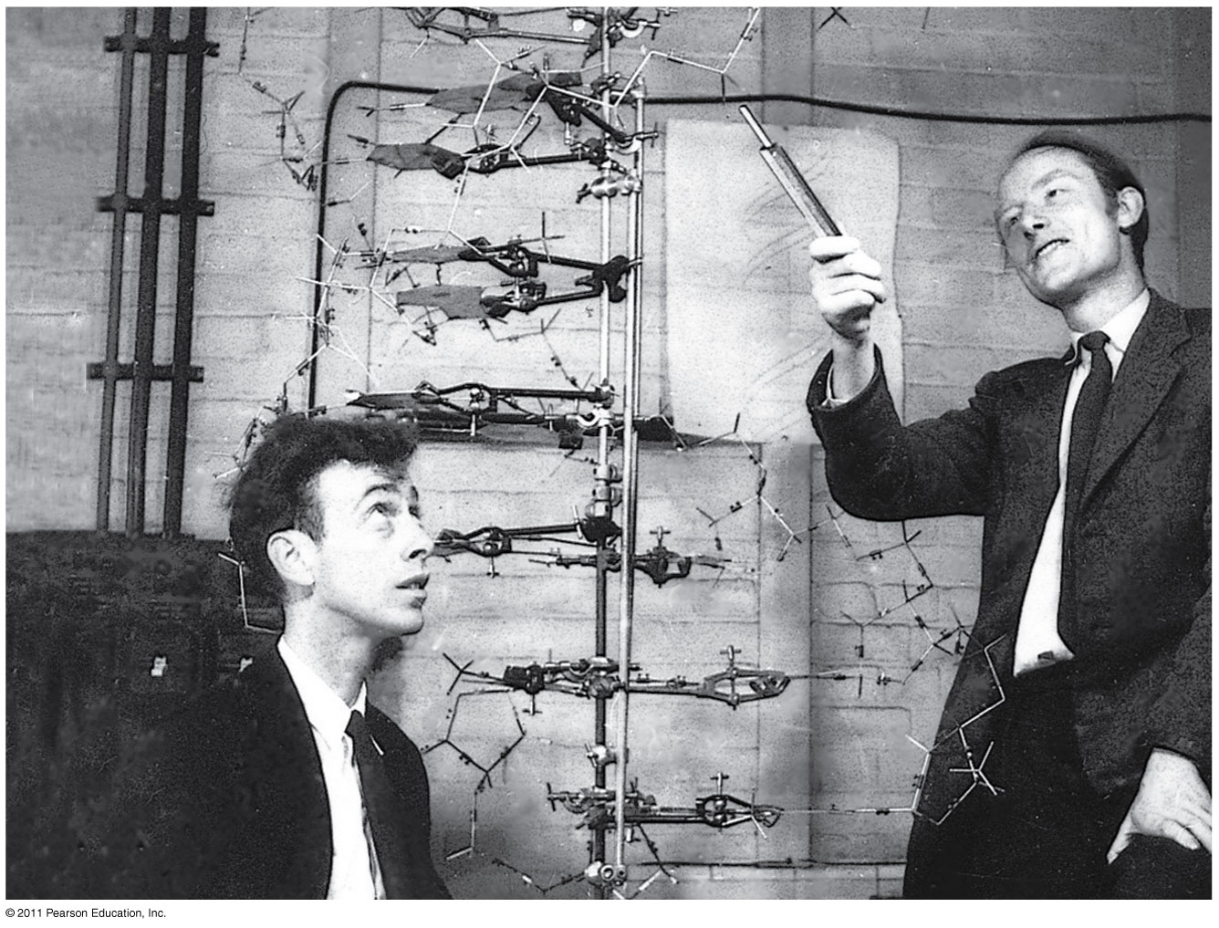
Watson and Crick (1953)
Used evidence from previous scientists to build a model of DNA.
Won the Nobel prize in 1962

Slide 11
Essential Question #2
Why is DNA replication essential to the cell cycle?

Slide 12
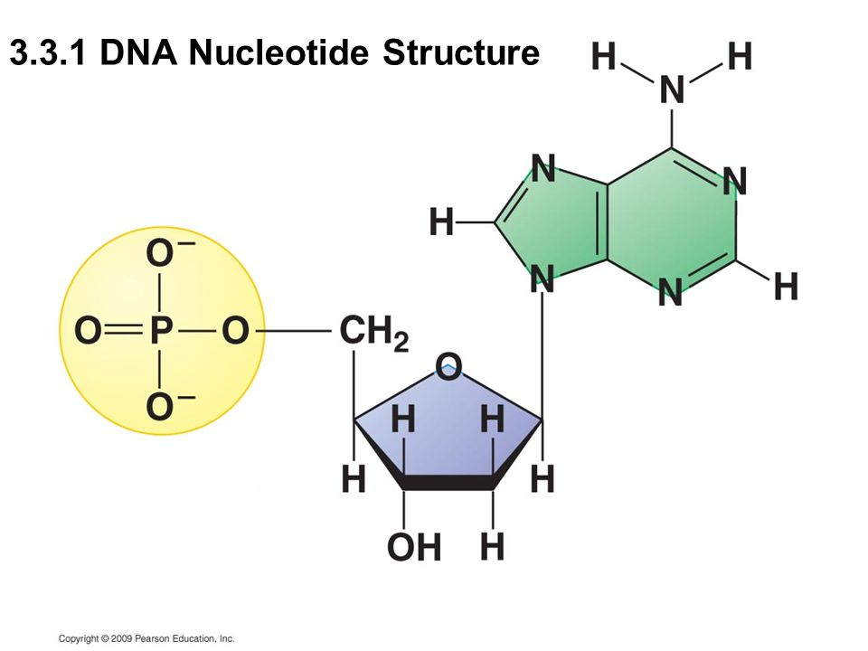
Nucleotide structure
Nucleotides are the monomers that make up the Nucleic Acid polymer.
Nitrogenous Base
Phosphate Group
Deoxyribose Sugar

Slide 13
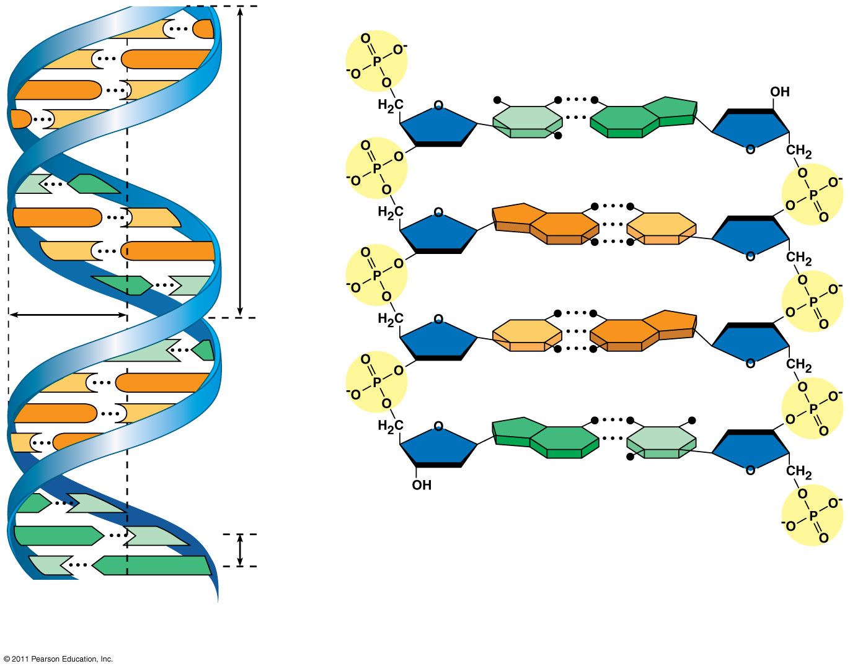
DNA structure
5′ end
C
G
DNA is a double helix
The “backbone” is made of alternating phosphate groups and deoxyribose sugars
The bases in the middle pair A to T and G to C
C
G
Hydrogen bond
3′ end
G
C
G
C
T
A
3.4 nm
T
A
G
C
G
C
C
G
A
T
1 nm
C
G
T
A
C
G
G
C
C
G
A
T
A
T
3′ end
A
T
0.34 nm
T
A
5′ end
(a)
Key features of DNA structure
(b) Partial chemical structure

Slide 14
Nitrogenous Base Pairing
Adenine pairs with Thymine
A T
Guanine pairs with Cytosine
G C
Chargaff’s Rules

Slide 15
Forms of Eukaryotic DNA
Eukaryotic DNA comes in two forms:
1) Chromatin – nucleic acid strands are unwound and in a “spaghetti” arrangement
Found only during Interphase
2) Chromosome – nucleic acid strands are tightly wound around histone proteins, and folded on scaffolding proteins
Found only during Mitotic stages

Slide 16
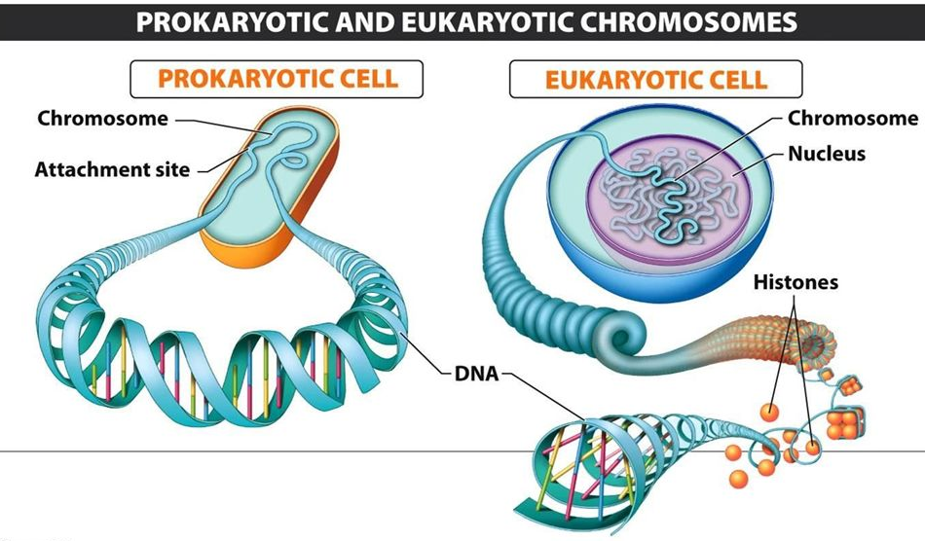
Prokaryote vs. Eukaryote DNA
Prokaryotes have a single loop of DNA
Eukaryotes have multiple strands/strings of DNA

