Slide 1
Enzymes

Slide 2
TEKS and S.E.s
B.9C identify and investigate the role of enzymes

Slide 3
Vocabulary
Enzyme
Catalyst
Substrate
Active site
Substrate-enzyme complex
Activation energy
Inhibitor
Catabolic
Anabolic
Reactant
Product

Slide 4
Prerequisite Questions
What type of biomolecule makes up an enzyme?
What is a chemical reaction?
What is the reactant in a chemical reaction?
What is the product in a chemical reaction?

Slide 5
Essential Question
How is an enzyme’s function connected to its structure?

Slide 6
WHAT is an enzyme? HOW do they work?
THE BIG IDEA:
An ENZYME is a PROTEIN that functions as a catalyst to SPEED UP a CHEMICAL REACTION in an organism;
Enzymes are biological catalysts.
Catalyst speed up reactions.
These reactions would take place anyway… the enzymes just speed them up!
Catalysts are NOT used up in the chemical reaction, rather it is recycled and used over and over again

Slide 7
4 CHARACTERISTICS of Enzymes –
Enzymes do not make anything happen that couldn’t happen on its own, just makes it happen faster.
Enzymes are not used up in reactions. They can be used over and over again!
Enzymes are highly specific: each enzyme catalyzes a specific chemical reaction, acting on a specific substrate
Enzymes are only needed in small amounts.

Slide 8
How is an enzymes shape related to its function??
THE BIG IDEA: An enzyme’s STRUCTURE DETERMINES its FUNCTION!!!!
The part of the enzyme that binds to the substrate is called the active site. The active site has a shape that precisely matches the shape of the molecule to be reacted, called the substrate.
When the substrate and enzyme bind temporarily, an enzyme-substrate complex is formed.

Slide 9
“Lock and Key” Analogy
Enzyme specificity is often described using the “lock-and-key” model of enzyme action:
The shape of the enzyme’s active site (the “Key’s teeth”) determines which substrate (which “Lock”) will “fit” with the enzyme.
If the substrate (“lock”) doesn’t match with the active site (“key”), the enzyme cannot catalyze the chemical reaction

Slide 10
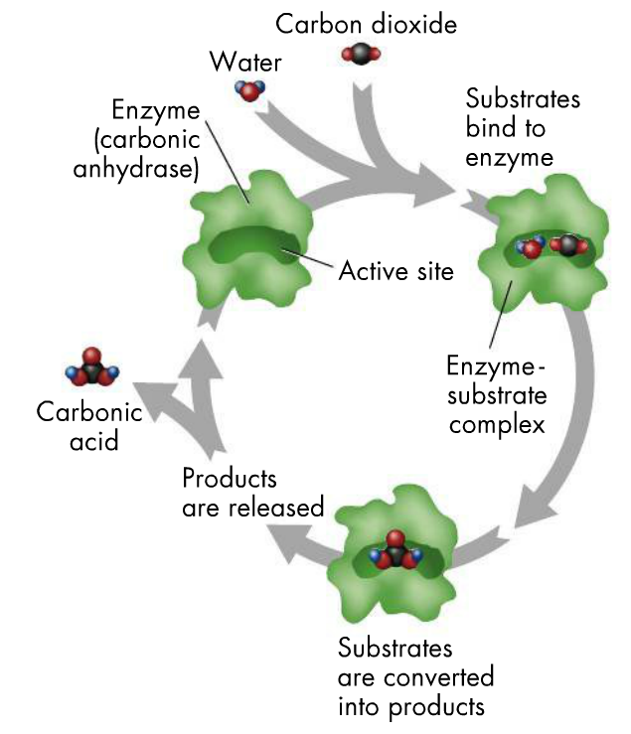
You try:
With a partner, see if you can describe what is happening at each step (letters) AND label the following parts (numbers)
Word Bank:
Enzyme
Enzyme-Substrate Complex
Active Site
Substrates bind to the active site
Products are released
Substrates are turned into products
A.
1.
2.
3.
C.
B.

Slide 11
Remember these key ideas…
The SUBSTRATE is the REACTANT in the chemical reaction that is catalyzed by the enzyme, the substance that is CHANGED
The ACTIVE SITE is the region on the enzyme where the substrate attaches; the shape of the active site determines which substrates the enzyme can bind.
Imagine a KEY (the ACTIVE SITE) fitting a LOCK (the SUBSTRATE).
The PRODUCT is what you end up with after the chemical reaction has occurred.

Slide 12
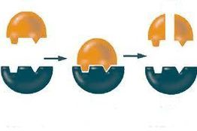
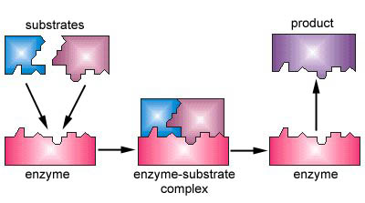
Enzyme Classification
Catabolic Reaction
Bonds are being broken
Anabolic Reaction
Bonds are being created

Slide 13
HOW do enzymes CATALYZE chemical reactions??
Enzymes speed up the rate of chemical reactions by lowering the required activation energy (the amount of energy needed to start the reaction).

Slide 14
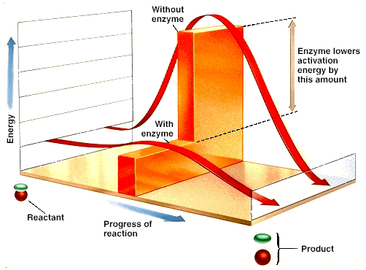
The activation energy needed for the reaction to occur is reduced.
After the reaction is complete, the substrate has formed a new product or products and the enzyme is released to be reused.

Slide 15
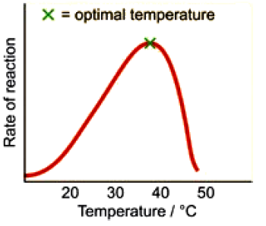
What environmental FACTORS can affect an ENZYME’S FUNCTION?
1. Temperature:
THE BIG IDEA: Enzymes function optimally at certain temperatures.
BUT, if it gets TOO HOT, the enzyme
becomes “DENATURED” as the heat
“cooks” the protein.
OPTIMAL TEMPERATURE for an
enzyme is when enzyme
“works best.”

Slide 16
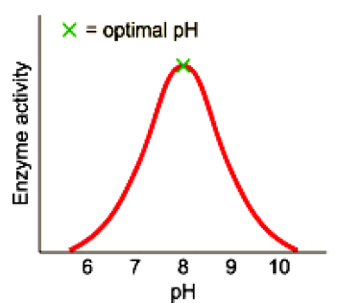
2. pH (a measure of acidity)
THE BIG IDEA: Enzymes function optimally at a certain pH.
If the pH is too low (too acidic) or too high (too basic), the
enzyme becomes “DENATURED”
OPTIMAL pH for an enzyme is the pH at
which is when it “works best

Slide 17
3. Concentration of substrate
Reaction rate increases as the substrate concentration increases up to a point
The limiting factor
in the reaction may
be the amount of
substrate or the
amount of enzyme
available

Slide 18
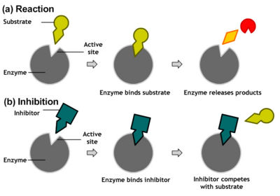
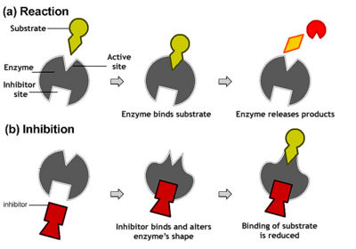
4. Inhibitor Molecules
Competitive inhibitors
Attach to enzyme’s active site
Shape is similar to substrate
Compete with the substrate
Often the end product of the reaction
b. Non-competitive inhibitors
Attach elsewhere on the
enzyme (not the active site)
Attachment changes the 3D
shape of enzyme
Reaction still occurs, but is
inhibited

Slide 19
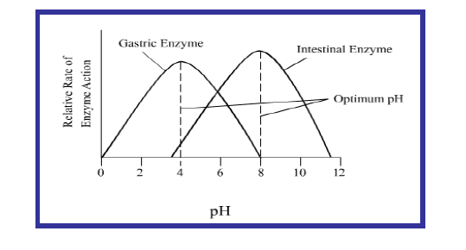
Based on the graph below, come up with two observations that are related to enzyme activity.

Slide 20
Concept Mastery Questions:
Why are enzymes so specific to the reaction they mediate?
What implications do inhibitors have on enzymatic activity?
How do enzymes speed up chemical reactions?
What happens to a biochemical process if one of the enzymes are denatured?
What would happen to the products (in boxes) if enzyme 2 is denatured?

