Slide 1
Diagrams for the Animal, Plant, Protist and Bacteria Comparison Poster Sheet

Slide 2
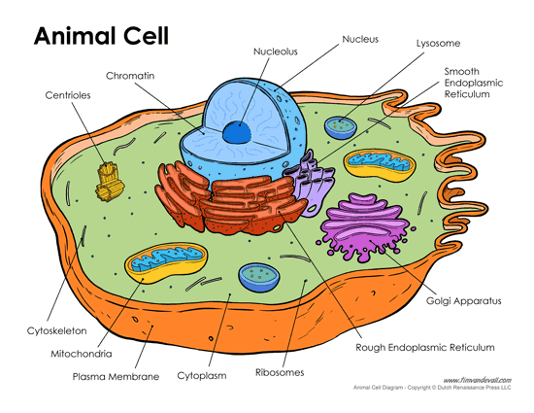
Eukaryote

Slide 3
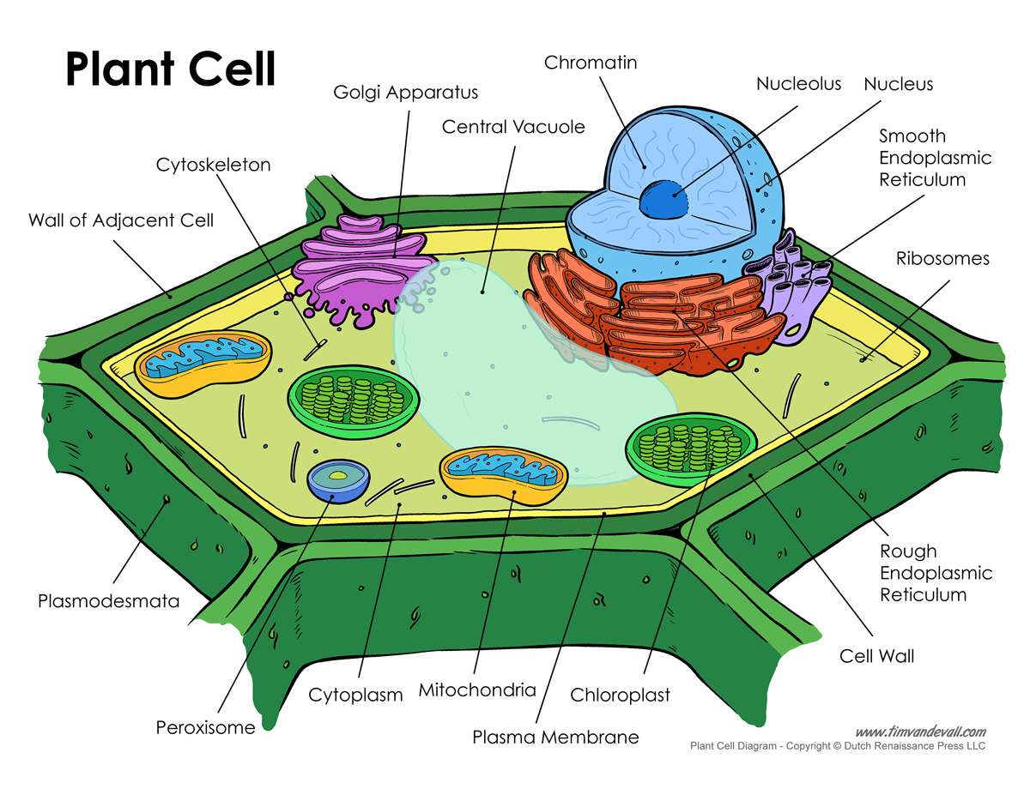
Eukaryote

Slide 4
Eukaryote
Protist Cell
(Euglena)

Slide 5
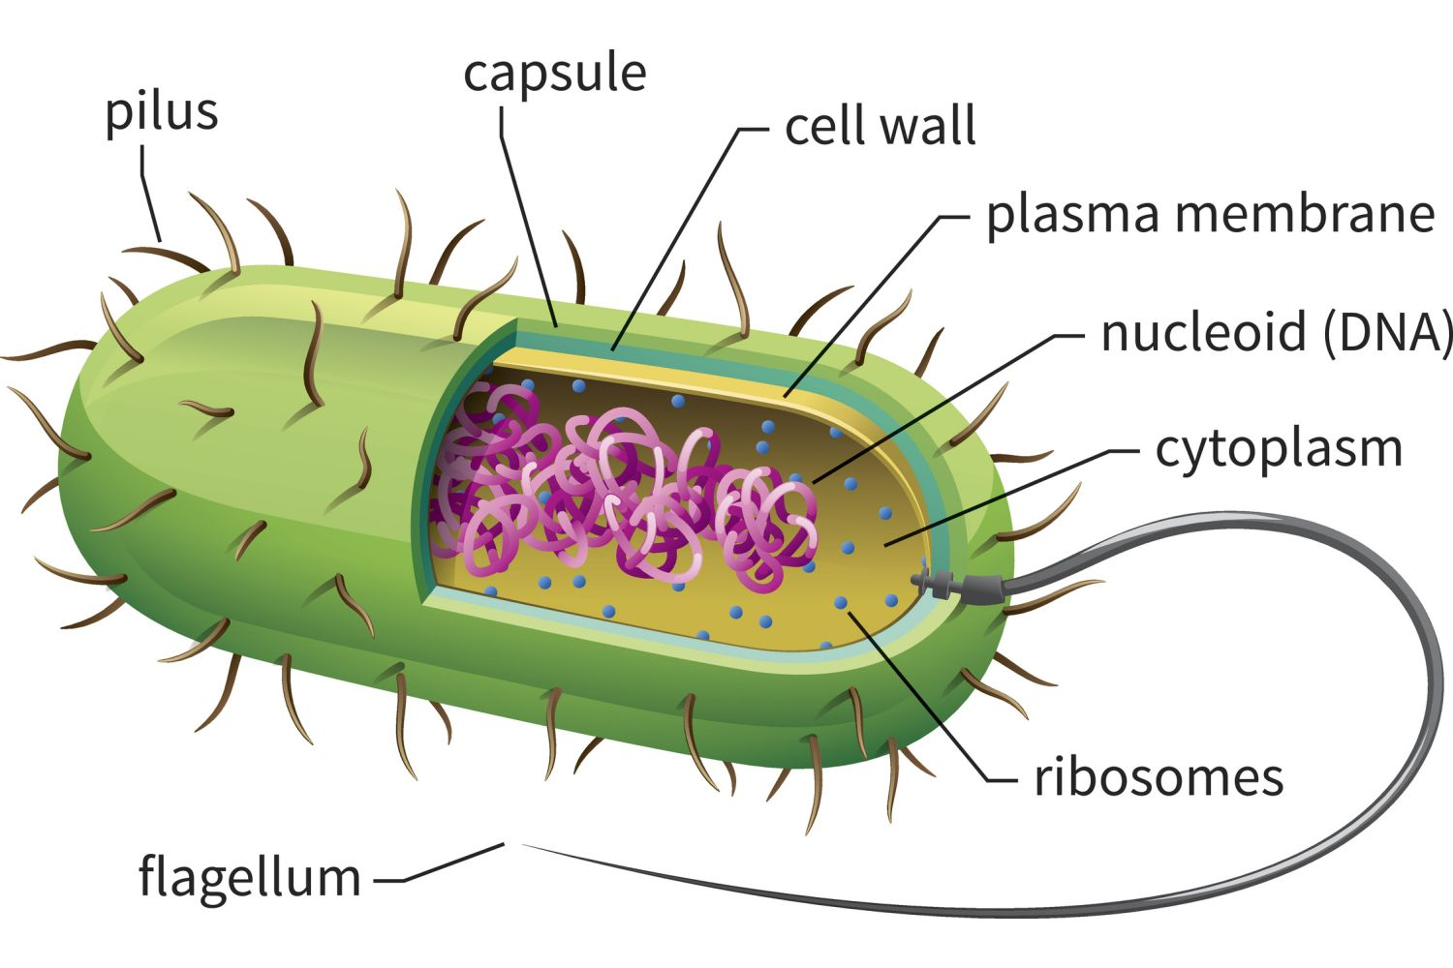
Prokaryote
Bacterial Cell

