Slide 1
How to alter the alleles in a population
Gene Flow, Genetic Drift, Bottle Neck Effect and Founder Effect

Slide 2
Natural Selection
Definition: A process in which individuals that have certain inherited traits tend to survive and reproduce at higher rates than other individuals because of those traits
Stresses from the environment creates situations where the organisms with a beneficial trait will survive and reproduce, those without will die off
Surviving organisms reproduce and contribute alleles to the gene pool.

Slide 3
Gene Pool
Definition: The total of all copies of every types of allele at all loci (locations) in every individual in a population
There are genetic differences between Populations A & B due to random mutations.
Population A
Population B

Slide 4
Gene Flow
Definition: When genetic material is moved through Immigration (Entering) or Emigration (Leaving) of a population.
If organisms enter or leave a population, they change the variability of the gene pool that can be genetically mixed through reproduction.
If an organism (red dot) moves from Pop A to Pop B and reproduces, then Population A’s genetic diversity will decrease, while Population B’s genetic diversity will increase.
Population A
Population B

Slide 5
Genetic Drift
Definition: A process in which chance events cause unpredictable fluctuations in allele frequencies from one generation to the next.
Has a more negative effect on smaller populations, because the gene pool is already limited

Slide 6
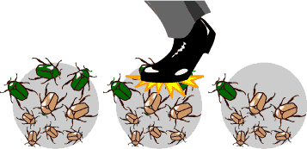
Genetic Drift
Something in the environment randomly affects organisms (only a few organisms are allowed to breed) over many generations.
This could limit the alleles that get passed on to the next generation, this limits the alleles in the gene pool.

Slide 7
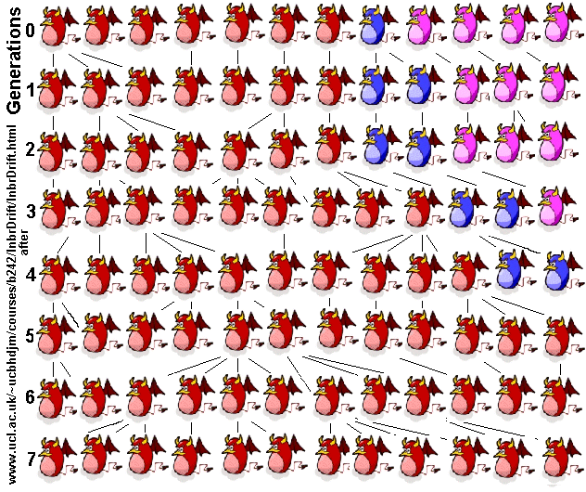

Slide 8
Concept Question: Genetic Drift
A population of flowers in a field consists of red, purple, pink and white varieties. Insects randomly move between the flowers, but do not go to each.
If bees randomly picked only red flowers to visit, what would happen to the flower population next year when this year’s seeds sprout?

Slide 9
Concept Question Answer
The alleles for the red color in flowers will become the prevalent (main) color for the population over time.
The population’s genotype has DRIFTED toward one phenotype. This reduces the genetic variability of the population.

Slide 10
Bottle Neck Affect
Definition: A kind of genetic drift that occurs when the size of a population is reduced, as by a natural disaster or human actions. Usually the surviving population is no longer genetically representative of the original population.
Only a few organisms live/survive to reproduce, this limits the alleles that can be passes on.

Slide 11
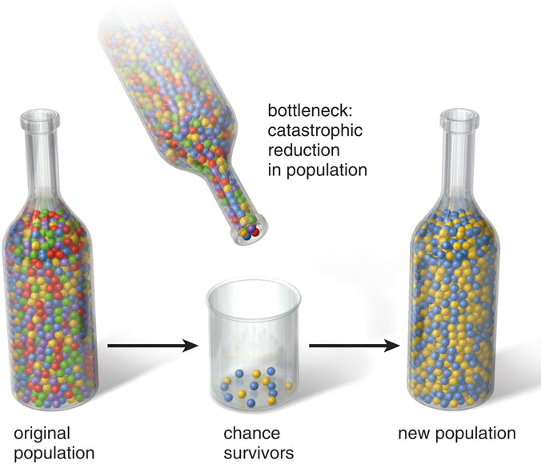

Slide 12
Concept Question: Bottle Neck Effect
A population of flowers in a field consists of red, purple, pink and white varieties. A herd of cows moves through and tramples the field only leaving 3 white and 1 pink flower alive
What is next year’s population in the field for these flowers going to look like phenotypically?

Slide 13
Concept Question Answer
Because there are more white flowers left, they will eventually out-reproduce the pink flowers. The alleles for the white color in flowers will become the prevalent (main) color for the population over time.
This reduces the genetic variability of the population.

Slide 14
Founder Effect
Definition: A kind of genetic drift that occurs when a few individuals become isolated from a larger population and form a new population whose gene pool composition is not reflective of the original population.
Since the new population is a small group, this limits the number of alleles in the gene pool.

Slide 15
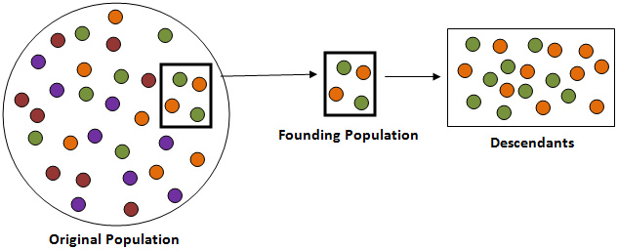

Slide 16
Concept Question: Founder Effect
A field biologist wants to repopulate a empty prairie dog nest with some prairie dogs from 10 miles away. The large nest 10 miles away has four phenotypic varieties: black, brown, white and tan. The biologist grabs 3 black and 3 tan prairie dogs to start the repopulate the old site.
How would you describe the phenotypes of the new population at the old site in 5 years?

Slide 17
Concept Question Answer
Because the new population is limited in the possible genotypes it can mix during reproduction, there will be no brown or white prairie dogs created. The FOUNDERS are the only ones that contribute genes to the population’s gene pool.
This reduces the genetic variability of the population.

Slide 18
Definition practice
Without looking at your notes and in your own words, create definitions for:
Natural Selection
Genetic Drift
Bottle Neck Effect
Founder Effect

