Slide 1
Genetic Analysis
Karyotyping, Pedigree and Gel Electrophoresis

Slide 2
Vocabulary
Karyotype
Autosome
Sex chromosome
Nondisjunction
Monosomy
Trisomy
Pedigree
Carrier
Restriction enzyme
Restriction site
Restriction fragment
Sticky ends
Recombination
Gel electrophoresis

Slide 3
Essential Question
How can scientists determine genetic conditions before a child is born?

Slide 4
Karyotype
Karyotype – a picture of the paired homologous chromosomes, taken during Prophase (sometimes Metaphase) of Mitosis, arranged from largest chromosome to smallest.
Purpose: Allows for the analysis of chromosomes, to show abnormalities.
Chromosomes arranged in homologous pairs and ordered from largest to smallest

Slide 5
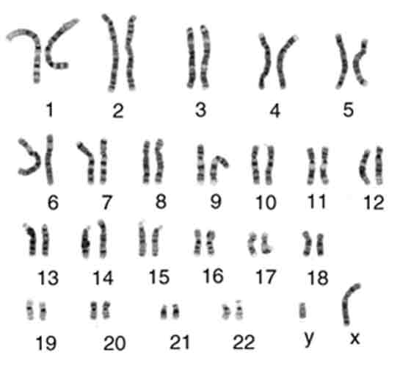
Karyotype vocabulary
Autosomes – chromosome numbers 1 – 22 in humans
Sex chromosomes – chromosome set 23 (X’s and Y’s)

Slide 6
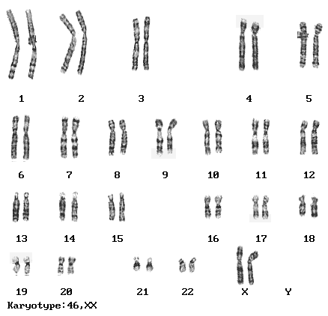
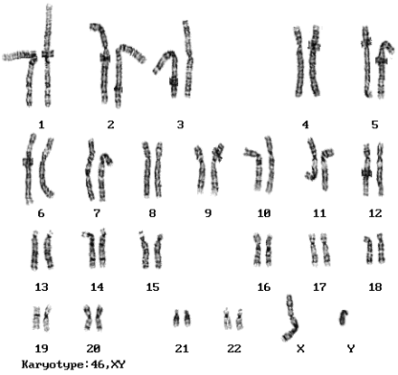
Normal Female
Normal Male

Slide 7
Karyotype vocabulary
Nondisjunction – a failure to separate chromosomes or chromatids in any anaphase stage.
Use your science to break down the word… Junction – to be together Disjunction – to come apart Nondisjunction – failure to come apart, and stays together

Slide 8
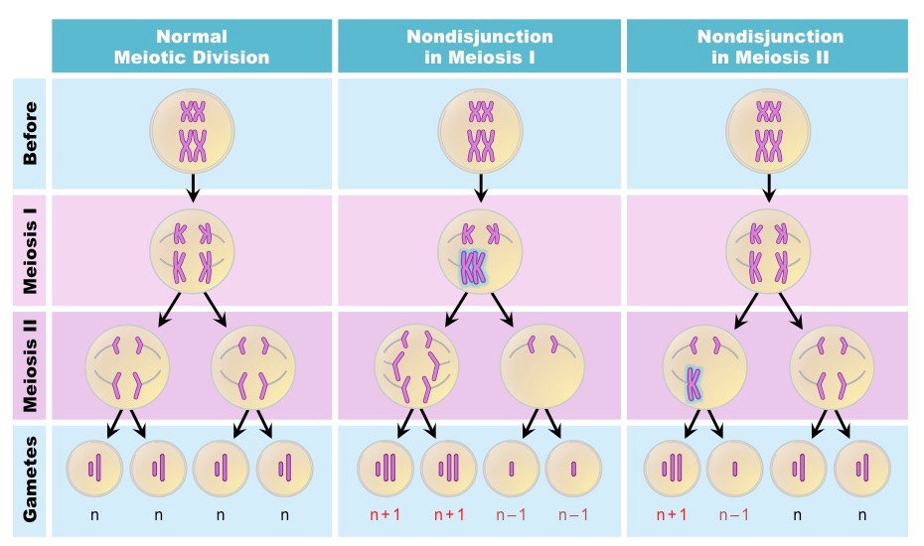
Nondisjunction Examples

Slide 9
Karyotype vocabulary
Nondisjunction mutations create gametes with too few or too many chromosomes.
When those gametes fertilize normal gametes, the diploid numbers are off. In humans they do not equal 46 chromosomes.
Monosomy – A cell with too few chromosomes. One of the homologous pairs is a single chromosome ( 2n = 45 in humans)
Trisomy – A cell with too many chromosomes. One of the homologous pairs has 3 total chromosomes (2n = 47 in humans)

Slide 10
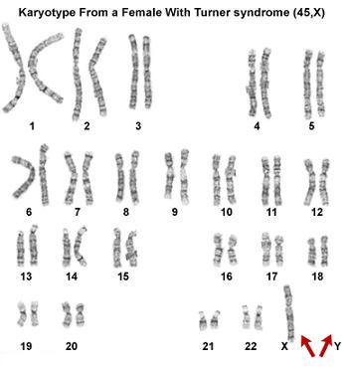
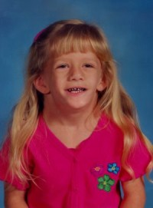
Turner’s Syndrome
Missing a X chromosome on 23rd chromosome
Causes underdeveloped ovaries, short stature, webbed, and only found in women.
Bull neck and broad chest. Individuals are sterile and lack expected secondary sexual characteristics.
Mentally handicapped typically not evident.

Slide 11
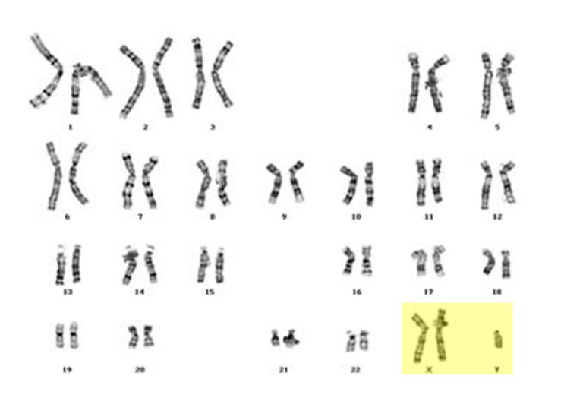
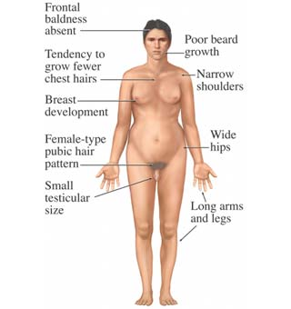
Kleinfelter’s Syndrome
Caused by nondisjunction of the X chromosome on 23rd chromosome (XXY, XXYY)
Males with some development of breast tissue
Individuals have little body hair, typically tall, and have small testes.
Infertility results from absent sperm.
Mental handicapped may or may not be present.

Slide 12
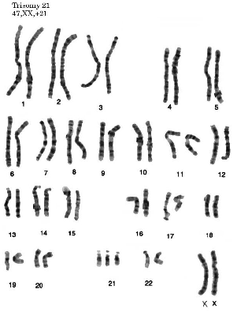
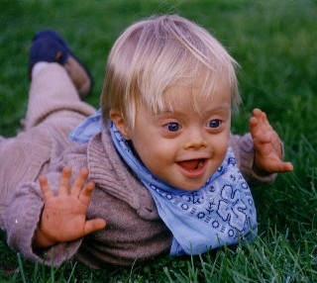
Down Syndrome
Caused by non-disjunction of the 21st chromosome.
The individual has a trisomy 21.
Some form of mental retardation is usually present

Slide 13
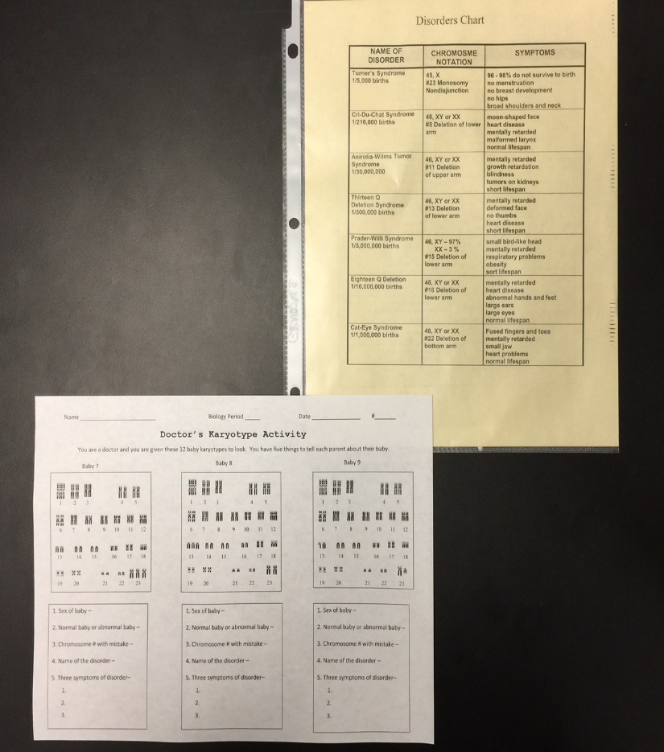
Practice reading a Karyotype
Use the pages from Doctor’s Karyotype Activity and the Disorder chart to identify the condition and sex of the individual.

Slide 14
Pedigree
A Pedigree is a graphical representation of genetic crosses covering multiple generations.

Slide 15
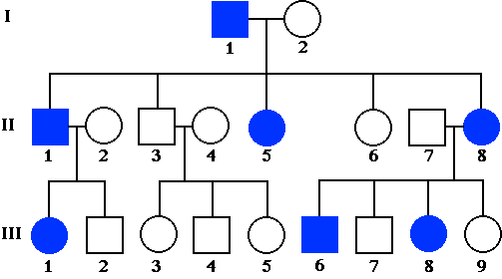
How to read a pedigree…
How many generations are shown?
How many affected people are there?
How many affected people are female?
How many affected people are male?
3
7
4
3

Slide 16
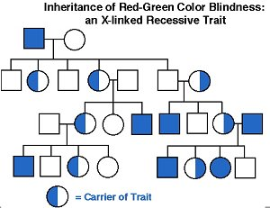
Pedigree showing sex-linked trait
All carriers are female. Most affected are male.

Slide 17
Bozeman Genetic Analysis video
Watch the following video…
http://www.bozemanscience.com/molecule-biology/

Slide 18
Gel Electrophoresis
Technique used to sort and compare DNA from different sources (individuals)
Restriction enzymes must be used to cut the DNA into small pieces called restriction fragments.
Restriction enzymes can only work on VERY specific sequences of DNA called restriction sites.

Slide 19
Restriction Enzymes
Restriction enzymes, like all enzymes, are very specific.
Most restriction enzymes you will see are based off of prokaryotic enzymes (EcoR1, BamH1, HinD3, etc)
Each enzyme cuts a different sequence of nitrogenous bases in DNA.
Think of restriction enzymes like a pair of scissors.

Slide 20
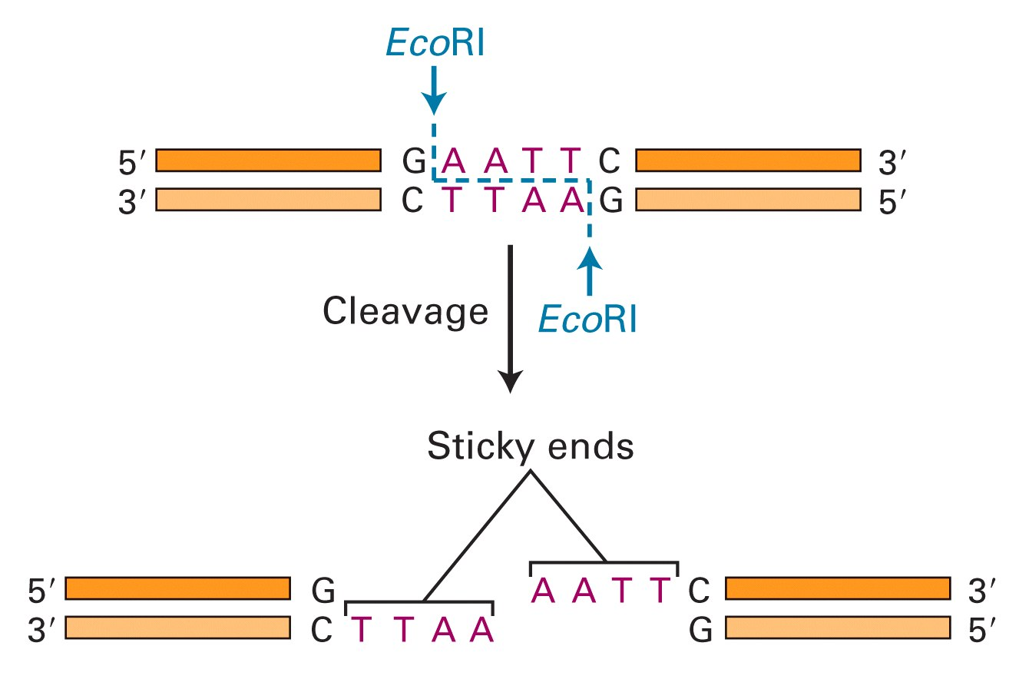
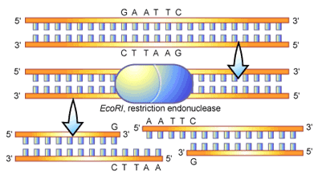
EcoRI example
Many restriction enzymes leave “sticky ends” when they cut.
These “sticky ends” want to pair back up following base pairing rules.

Slide 21
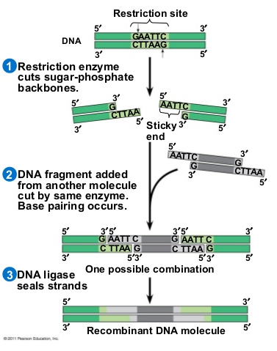
Recombinant DNA
If the same restriction enzyme is used on different DNA pieces, all cuts will make the same “sticky ends” and the pieces can be connected.
Using this method scientists can merge the DNA of different organisms.

Slide 22
Or…organize the fragments by length!
Gel electrophoresis uses the fact that DNA is a negatively charged molecule.
If the fragments are pushed/pulled from a negative end of agar gel, to the positive end, then they can be separated by size.
Small pieces of DNA will travel faster/further to the positive end, than larger pieces of DNA (which get stuck/move slow).

Slide 23
Gel plate creation
It is harder for the large DNA pieces to move through the agar protein matrix (think of this as a set of monkey bars on a playground)
Small pieces can move very quickly through the agar gel matrix (monkey bars) and get to the positive end faster.
This sorts the DNA pieces cut by restriction enzymes by length over time

Slide 24
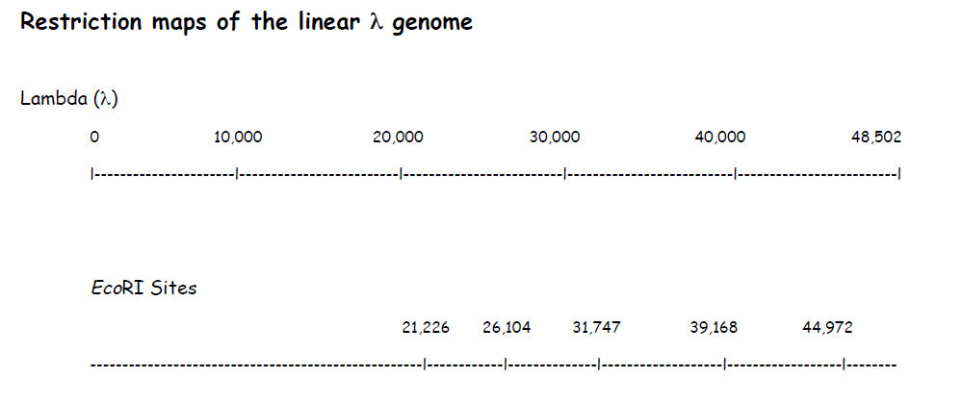
Draw a Gel Electrophoresis Plate
Practice work…
Step 1 – calculate the length of the first fragment using EcoR1.
Subtract the final number (21,226 bps) from the initial number (in this case 0 bps) and you get…
21,226 – 0 = 21,226
Fragment 1

Slide 25
Draw a Gel Electrophoresis Plate
Step 2 – calculate the length of the next fragment using EcoR1.
Subtract the final number (26,104) from the initial number (21,226) and you get…
26,104 – 21,226 = 4,878 bps
Fragment 2

Slide 26
Draw a Gel Electrophoresis Plate
Step 3 and beyond – repeat steps for each fragment
Subtract the final number (31,747) from the initial number (26,104) and you get…
31,747 – 26,104 = 5,643 bps
Fragment 3

Slide 27
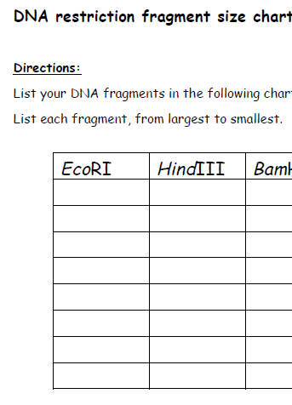
Record in the table on next page
Put the fragments in order from largest to smallest in the table on the next page for each restriction enzyme.
21,226
7,421
5,804
5,643
4,878
3,530

Slide 28
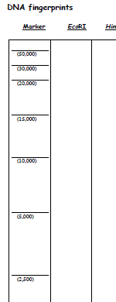
Draw a line representing the length
Draw lines for the fragment lengths at the appropriate position bases on the marker lengths.
Congratulations, you just made an electrophoresis plate.

