Slide 1
Mutations

Slide 2
TEKS
(6) Science concepts. The student knows the mechanisms of genetics, including the role of nucleic acids and the principles of Mendelian Genetics. The student is expected to:
(E) Identify and Illustrate changes in DNA and evaluate the significance of these changes.

Slide 3
Vocabulary
Mutation
Mutagen
Point Mutation
Frame shift
Insertion
Deletion
Missense mutation
Nonsence mutation
Chromosomal Mutation
Inversion
Translocation

Slide 4
Prerequisite Questions
How does DNA store our genetic information?
What are the processes that create proteins in cells?

Slide 5
Essential Question
How do mutations affect DNA, RNA and proteins?

Slide 6
What is a gene mutation?
A mutation is any change in the Nucleic Acid (DNA/RNA) sequence.
Can be caused by:
Errors in replication
Errors in transcription
Errors in cell division
Mutagens

Slide 7
Mutagens
Mutagen - any agent that can cause a mutation
These are caused by factors in the environment such as:
Radiation (x-rays, UV, nuclear)
Chemicals
Extremely high temperatures
Biological agents such as HPV
Named examples of mutagens:
Any mutagen that causes cancer is a carcinogen
Any mutagen that causes birth defects is a teratogen

Slide 8
How common are mutations?
Mutations occurs at a frequency of about 1 in every 1 billion base pairs.
That’s about 1 for every 6-7 chromosomes
Everybody has about 6 mutations in each cell in their body!

Slide 9
Are all Mutations harmful?
Silent or missense mutation – a change in the nucleotide sequence that creates a different codon that still codes for the same amino acid.
Remember, some amino acids have multiple codons that code for them:
Nonsense mutation – a change in the nucleotide sequence that causes a STOP codon to appear in the middle of a protein sequence.

Slide 10
Types of Mutations
Point Mutations
Substitution
Insertion w/ frameshift
Deletion w/ frameshift
Chromosomal Mutations
Duplication (a piece copied)
Deletion (a piece missing)
Inversion (a piece flipped)
Translocation (a piece(s) moved to another location)

Slide 11
Point Mutation: Substitution
Substitution mutation – a different nitrogenous base is substituted for the original nitrogenous base.
Normal DNA: TAC – TGC – ATC – GGG – CTA
Mutated DNA: TAC – TGC – TTC – GGG – CTA
Where is the mutation and what is happening?

Slide 12
Point Mutation: Substitution
Substitution mutation – a different nitrogenous base is substituted for the original nitrogenous base.
Normal DNA: TAC – TGC – ATC – GGG – CTA
Mutated DNA: TAC – TGC – TTC – GGG – CTA
In the 3rd codon set, adenine is replaced with thymine.
How many amino acids will be affected?

Slide 13
Point Mutation: Substitution
Substitution mutation – a different nitrogenous base is substituted for the original nitrogenous base.
Normal DNA: TAC – TGC – ATC – GGG – CTA
Mutated DNA: TAC – TGC – TTC – GGG – CTA
Only the 3rd amino acid will be changed

Slide 14
Point Mutation: Substitution
Substitution mutation – a different nitrogenous base is substituted for the original nitrogenous base.
Original protein from DNA: Met – Thr – (STOP)
ATC would code for : STOP
Mutated protein: Met – Thr – Lys – Pro – Asp.A.
TTC would code for: Lysine

Slide 15
Substitution Mutation Analogy 1
Compare the sentences below. All the words have 3 letter words to simulate a codon in mRNA.
THE DOG BIT THE CAR
THE DOG BIT THE CAT
THE DOG HIT THE CAR
THE HOG BIT THE CAR
THE LOG BIT THE CAR
THE DOG FIT THE CAR
The message (protein) is still mostly understandable.

Slide 16
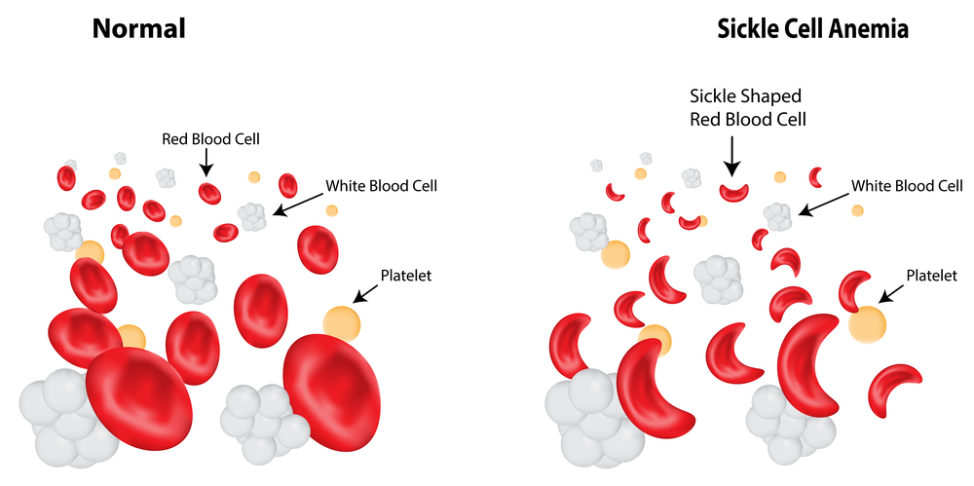
Example of Substitution mutations
Sickle Cell – abnormal red blood cells cause by a Thymine to Adenine substitution in the 6th codon.
Sickle Red blood cells can not carry oxygen as well

Slide 17
Point Mutation: Insertion w/ Frameshift
Insertion mutation – a new nitrogenous base is added to the original nitrogenous base sequence shifting all the following bases to the right.
Normal DNA: TAC – TGC – ATC – GGG – CTA
Mutated DNA: TAC – TAG – CAT – CGG – GCT – A
Where is the mutation and what is happening?

Slide 18
Point Mutation: Insertion w/ Frameshift
Insertion mutation – a new nitrogenous base is added to the original nitrogenous base sequence shifting all the following bases to the right.
Normal DNA: TAC – TGC – ATC – GGG – CTA
Mutated DNA: TAC – TAG – CAT – CGG – GCT – A
In the 2nd codon set, adenine is added causing a shift to the right.
How many amino acids will be affected?

Slide 19
Point Mutation: Insertion w/ Frameshift
Insertion mutation – a new nitrogenous base is added to the original nitrogenous base sequence shifting all the following bases to the right.
Normal DNA: TAC – TGC – ATC – GGG – CTA
Mutated DNA: TAC – TAG – CAT – CGG – GCT – A
The 2nd, 3rd, 4th and 5th codons (basically anything that comes after)

Slide 20
Point Mutation: Insertion w/ Frameshift
Insertion mutation – a new nitrogenous base is added to the original nitrogenous base sequence shifting all the following bases to the right.
Original protein from DNA: Met – Thr – (STOP)
Mutated protein: Met – Iso – Val – Ala – Arg
2nd, 3rd, 4th and 5th codon reading frames have shifted changing the STOP codon.

Slide 21
Point Mutation: Deletion w/ Frameshift
Deletion mutation – a new nitrogenous base is deleted from the original nitrogenous base sequence shifting all the following bases to the left.
Normal DNA: TAC – TGC – ATC – GGG – CTA
Mutated DNA: TAC – TGC – TCG – GGC – TA
Where is the mutation and what is happening?

Slide 22
Point Mutation: Deletion w/ Frameshift
Deletion mutation – a new nitrogenous base is deleted from the original nitrogenous base sequence shifting all the following bases to the left.
Normal DNA: TAC – TGC – ATC – GGG – CTA
Mutated DNA: TAC – TGC – TCG – GGC – TA
In the 3rd codon set, adenine is removed causing a shift to the left.
How many amino acids will be affected?

Slide 23
Point Mutation: Deletion w/ Frameshift
Deletion mutation – a new nitrogenous base is deleted from the original nitrogenous base sequence shifting all the following bases to the left.
Normal DNA: TAC – TGC – ATC – GGG – CTA
Mutated DNA: TAC – TGC – TCG – GGC – TA
The 3rd, 4th and 5th codons (basically anything that comes after)

Slide 24
Point Mutation: Deletion w/ Frameshift
Deletion mutation – a new nitrogenous base is deleted from the original nitrogenous base sequence shifting all the following bases to the left.
Original protein from DNA: Met – Thr – (STOP)
Mutated protein: Met – Thr – Ser – Pro
3rd, 4th and 5th codon reading frames have shifted changing the STOP codon

Slide 25
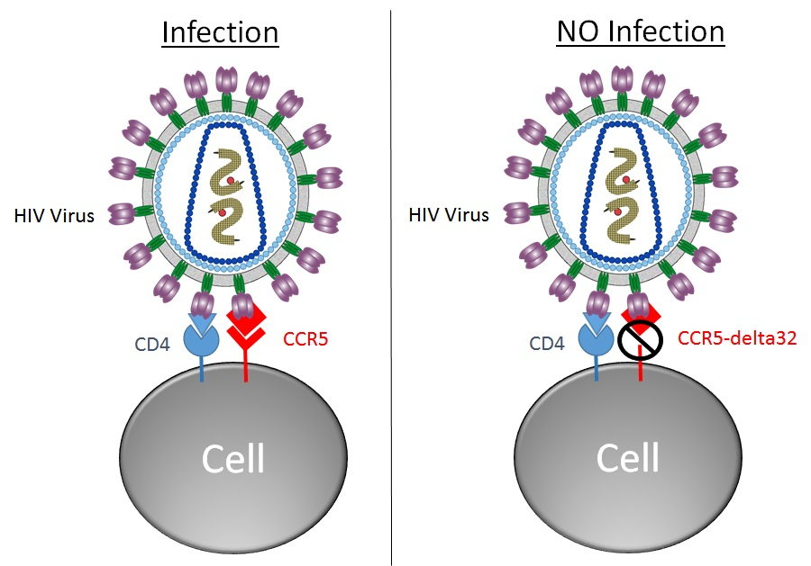
Example of Frameshift mutation
HIV susceptibility – a frameshift in the CCR5 gene which codes for the receptor protein the virus uses to enter the cell. An early stop codon (nonsense) cuts the protein short.
Individuals with this mutation are more resistant to HIV attacks, and do not contract HIV which leads to AIDS.

Slide 26
Frameshift Mutation Analogy 1
What happens to an answer document if you leave out an answer and slide all of the other answer up one number?
If you shift the answer reading frame, everything that comes after the shift (insertion/deletion) could potentially be wrong (mutation)

Slide 27
Frameshift Mutation Analogy 2
Compare the sentences below. All the words have 3 letter words to simulate a codon in mRNA.
THE DOG BIT THE CAR (Original, unmutated)
THH EDO GBI TTH ECA R (Insertion – H, 1ST Codon)
THE DOB ITT HEC AR (Deletion – G, 2nd Codon)

Slide 28
Chromosomal Mutation: Duplication
Large sections of genetic material (multiple genes) are copied and inserted into the same DNA sequence.

Slide 29
Chromosomal Mutation: Deletion
Large sections of genetic material (multiple genes) are removed from a DNA sequence.

Slide 30
Chromosomal Mutation: Inversion
Large sections of genetic material (multiple genes) are moved out of order in a DNA sequence.

Slide 31
Chromosomal Mutation: Translocation
Large sections of genetic material (multiple genes) are swapped between two different chromosomes.
We will see this in meiosis during Prophase 1. (Crossing Over)

Slide 32
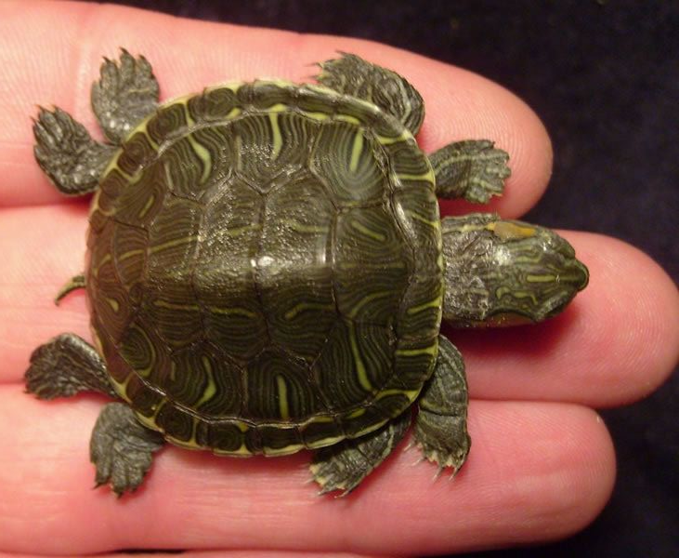
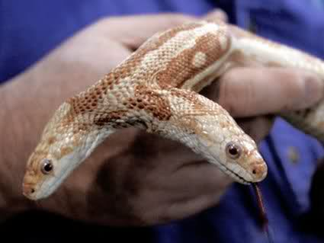
Are all Mutations harmful?
A change in the genetic code can be beneficial or harmful (even lethal)
Advantages
New genes created by mutations can add new adaptations to an organism making it able to outcompete a neighbor
Disadvantages
New genes created by mutations can reduce efficiency of a protein, or even remove a necessary protein making it deadly for the organism or its offspring

Slide 33
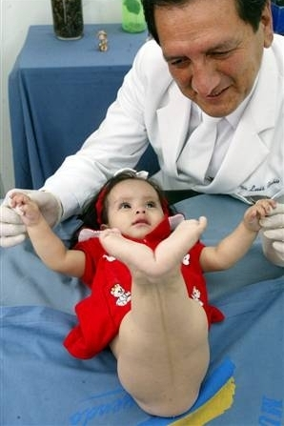
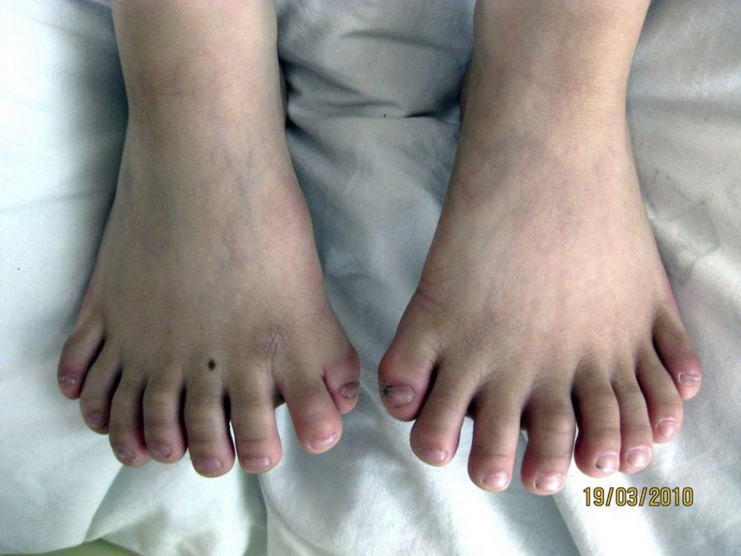
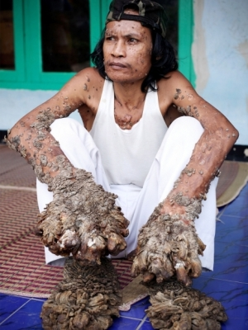
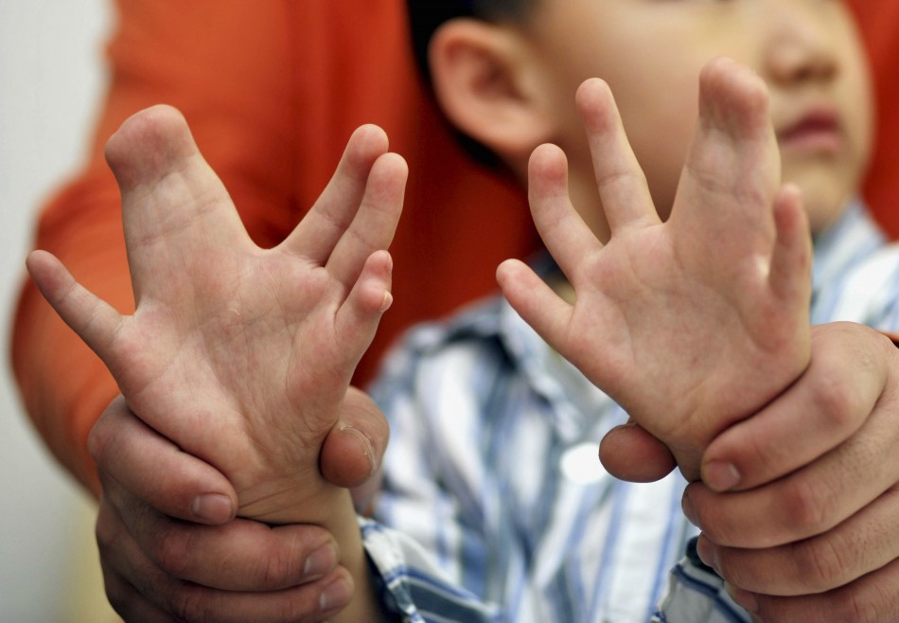
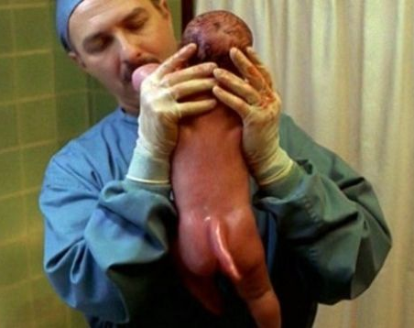
Are all Mutations harmful?

