Slide 1
Non Mendelian Genetics

Slide 2
TEKS
6 Science concepts. The student knows the mechanisms of genetics, including the role of nucleic acids and the principles of Mendelian Genetics. The student is expected to:
6F predict possible outcomes of various genetic combinations such as monohybrid crosses, dihybrid crosses and non-Mendelian inheritance;

Slide 3
Vocabulary
Genetics
Heredity
Hybrid
Monohybrid
Dihybrid
Gene
Trait
Allele
Dominant allele
Recessive allele
Homozygous
Heterozygous
(F1 generation)
(F2 generation)
Phenotype
Genotype
True-breeding
Incomplete Dominance
Co-dominance
Sex-linked trait

Slide 4
Prerequisite Questions
Where does an organisms get its genes from?
What does it mean for a trait to be dominant or recessive?

Slide 5
Essential Question
What happens if a trait does not follow complete dominance rules?

Slide 6
Dihybrid Crosses Poly-Genic Traits Multiple-Allele Traits Sex-linked Traits Incomplete Dominance Co-Dominance

Slide 7
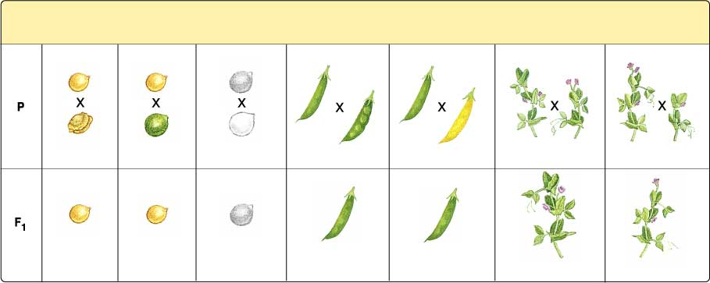
Pea traits that Mendel identified
Through multiple crosses, Mendel determined that all these traits displayed a mathematical predictability for inheritance.
Seed Shape
Seed Color
Seed Coat
Color
Pod
Shape
Pod Color
Flower Position
Plant Height
Round
Yellow
Gray
Smooth
Green
Axial
Tall
Wrinkled
Green
White
Constricted
Yellow
Terminal
Short
Round
Yellow
Gray
Smooth
Green
Axial
Tall

Slide 8
Law of independent assortment
Because organisms are made up of more than one trait, Mendel concluded that the inheritance of one trait does not influence the inheritance of a second trait.
Example: Height of the pea plant does not influence the color of the peas
Height is independently assorted from color.

Slide 9
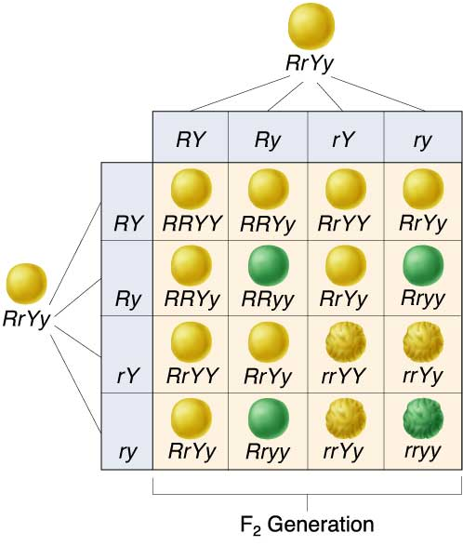
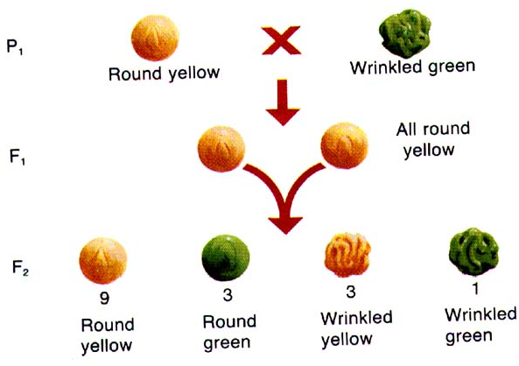
Dihybrid Cross
Dihybrid cross - working with two traits (gives twice as many gametes possibilities, so 4 times as many offspring) classical ratio of 9:3:3:1

Slide 10
Using dihybrid crosses to show independent assortment
A smooth, yellow pea (RrYy) can pass on these combinations of genes to its offspring: RY, Ry, rY, or ry.

Slide 11
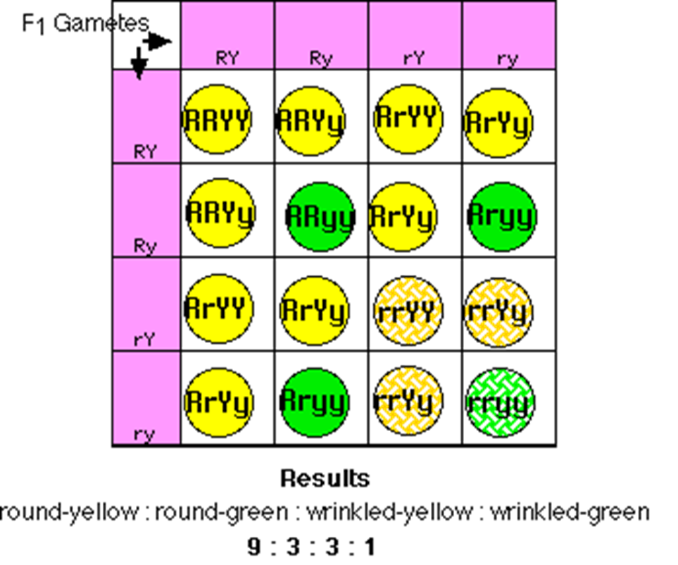

Slide 12
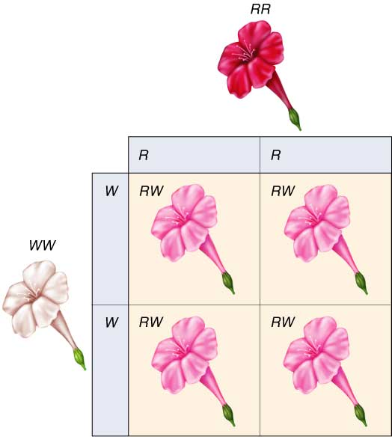
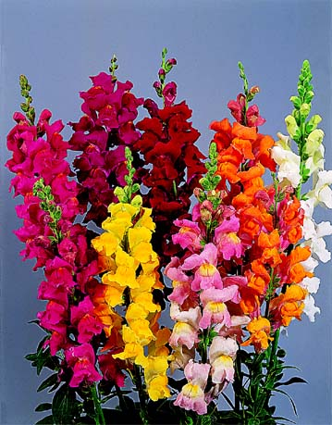
Incomplete dominance
Both alleles for a trait blend together creating a new expression in the heterozygous condition
examples: snapdragons

Slide 13
Variations on Mendel
Incomplete dominance: the heterozygous genotype shows a blend of the two parents and not the dominant allele

Slide 14
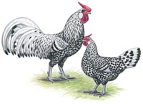
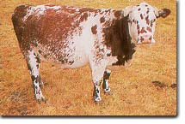
Co-dominance
Both alleles for a trait show up equally
Examples: roans, “checkered” chickens

Slide 15
Variations on Mendel
Codominance: the heterozygous genotype shows both inherited alleles
Example of roan horse coat: AA (dark red) x aa (white) → Aa (dark red and white)

Slide 16
Complete, Incomplete and Codominance Comparison
Cross two heterozygous individuals. Use the following alleles: A – black and a – white.
Complete Dominance
Cross: Aa x Aa
Punnett:
Ratios:
Genotype Phenotype
AA – 25% Black – 75%
Aa – 50% White – 25%
aa – 25%
Incomplete Dominance
Cross: Aa x Aa
Punnett:
Ratios:
Genotype Phenotype
AA – 25% Black – 25%
Aa – 50% Gray – 50%
aa – 25% White – 25%
Codominance
Cross: Aa x Aa
Punnett:
Ratios:
Genotype Phenotype
AA – 25% Black – 25%
Aa – 50% Black & White – 50%
aa – 25% White – 25%
 | A | a
A | AA | Aa
a | Aa | aa
 | A | a
A | AA | Aa
a | Aa | aa
 | A | a
A | AA | Aa
a | Aa | aa

Slide 17
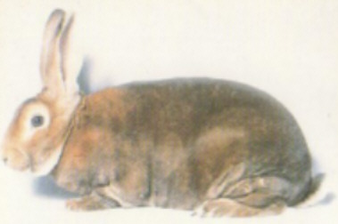
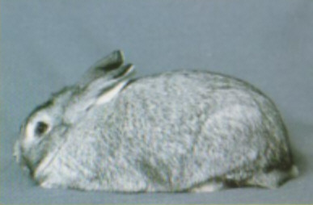
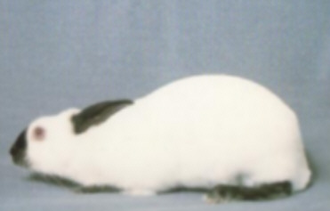
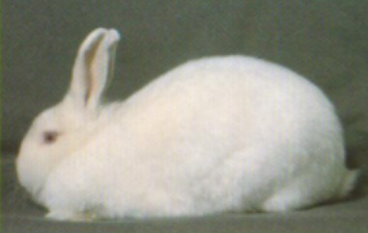
Multiple alleles
More than two alleles for a trait
Examples: coat color of rabbits
Key
C = full color
c^{ch} = chinchilla
c^{h} = Himalayan
c = albino
CC, Cc^{ch}, Cc^{h}, or Cc
c^{ch}c^{h}, c^{ch}c^{ch}, or c^{ch}c
c^{h}c or c^{h}c^{h}
cc

Slide 18
Variations on Mendel
Multiple alleles: when there are more than two alleles that code for a trait
Example: ABO blood type
A type = AA or Ao
B type = BB or Bo
O type = oo
AB type = AB

Slide 19
Blood typing

Slide 20
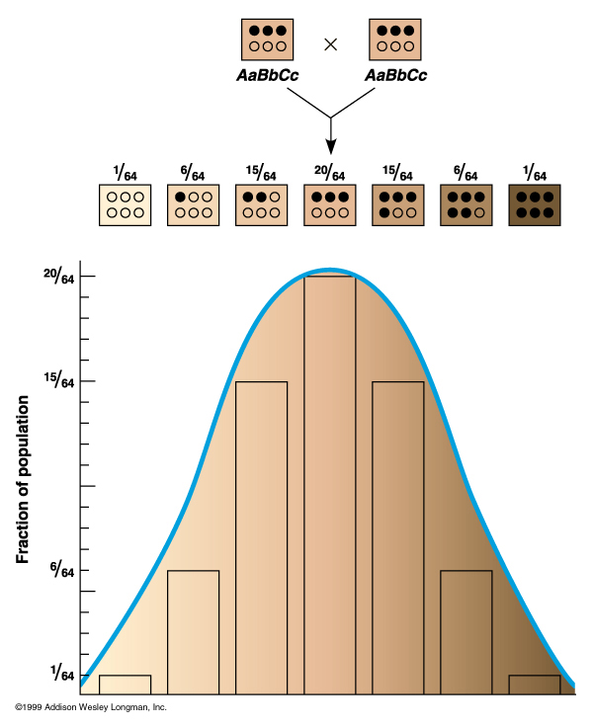
Polygenic inheritance
Many genes affect the expression of the trait
Examples: skin, eye, & hair colors

Slide 21
X-linked or Sex linked
Allele is carried on the X chromosome
Because females have 2 X chromosomes, often a mutated allele is hidden by the other healthy X
Only Females can be carriers for X linked
examples:
Hemophilia, Color blindness, Male patterned baldness
Usually written like this:
X X – normal female
X X* - carrier female (* designates some mutated allele)
X* X*- affected female
X Y – normal male
X* Y – affected male
 | X | Y
X | X X | X Y
X^{h} | X X^{h} | X^{h} Y

Slide 22
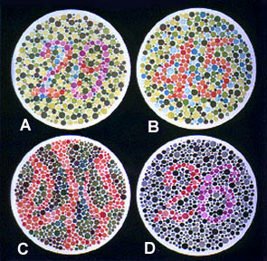
Sex-linked traits
A recessive gene on the X chromosome
Examples: color-blindness & hemophilia
Genotypes: Phenotypes:
XY normal male
X^{n}Y colorblind male
XX normal female
XX^{n} carrier female
X^{n}X^{n} colorblind female

Slide 23
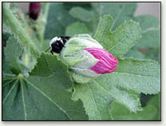
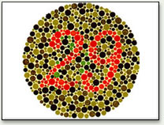
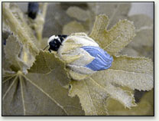
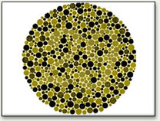
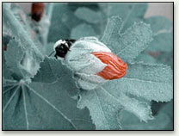
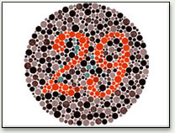
normal
vision
“weak red”
“weak green”

Slide 24
Are you red-green color blind?
Yes, if you have a difficult time distinguishing a number from this picture

Slide 25
Colored blindness – Sex linked How could a girl become colorblind?
X^{c}Y
XX^{c}
How should this diagram be changed?
X^{c}Y
XX^{c}
XY
X^{c}X^{c}
How do you know this girl is a carrier?

Slide 26
Hemophilia
Victoria was a carrier of the gene for hemophilia, a serious bleeding disorder

Slide 27
