Slide 1
The Purpose of Omega Notes
An introduction to the Omega Notes Process

Slide 2
TEKS
(There are no specific TEKS for note taking, but a few of the processing TEKS could apply)
(2) Scientific processes.
The student uses scientific practices and equipment during laboratory and field investigations. The student is expected to:
(H) communicate valid conclusions supported by the data through methods such as lab reports, labeled drawings, graphic organizers, journals, summaries, oral reports, and technology-based reports.

Slide 3
Vocabulary
Ebbinghaus Curve of Forgetting
Retention
Elapsed
Essential
Paraphrase
Costa Questioning
Technique
Anecdote

Slide 4
Prerequisite Questions/Content
What is the Cornell Style of note taking?

Slide 5
Essential Question 1
How does organizing and reviewing notes help to remember the content?

Slide 6
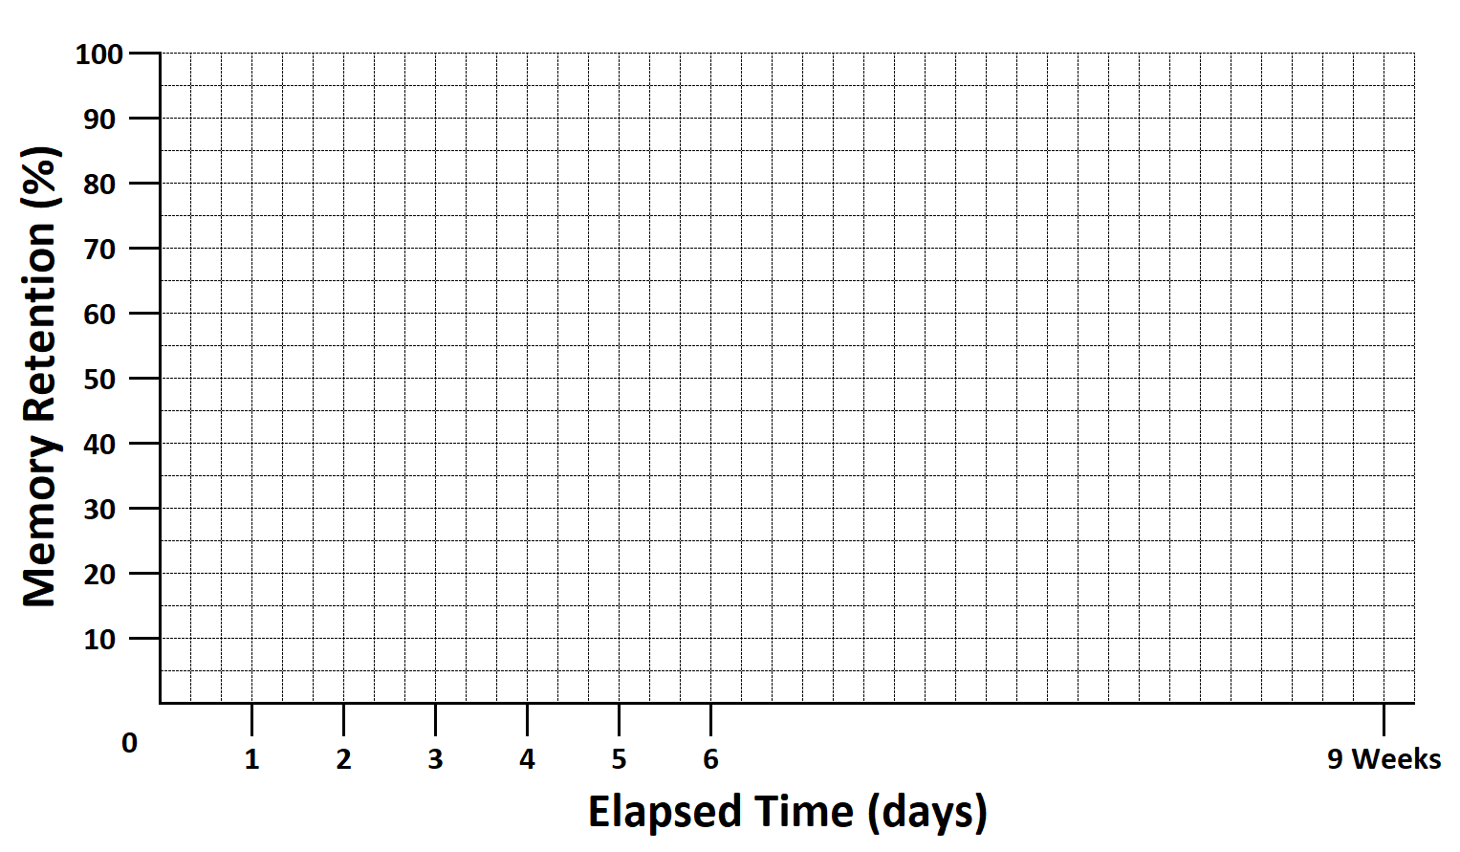
Ebbinghaus Curve of Forgetting
Where do you want your grade to be here?
First Time Learned
1st Review of Content
2nd Review of Content
3+ Reviews of Content
The instant you learn anything, you immediately start to forget it.
To remember (retain) the information you have to review or revisit the content.
The more you revisit the content, the more content you will remember

Slide 7
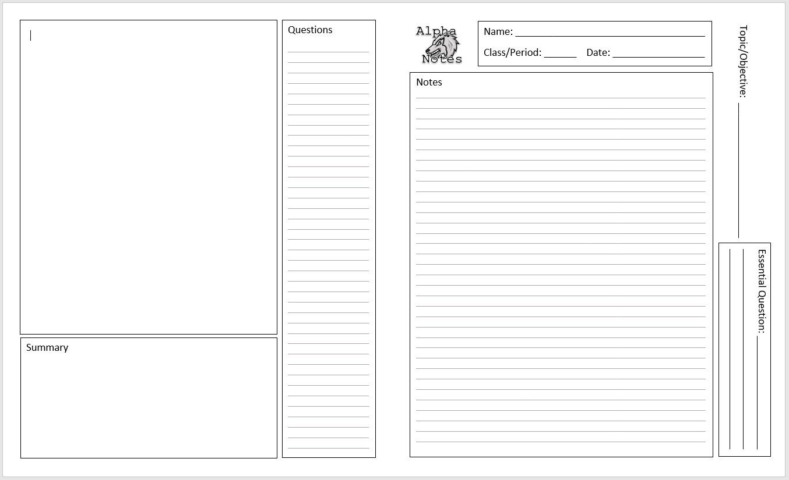
Butterfly Setup
Alpha Notes are designed to be used in a “Butterfly” format.
When writing/reviewing your notes, have the pages opened like the image to the right.

Slide 8
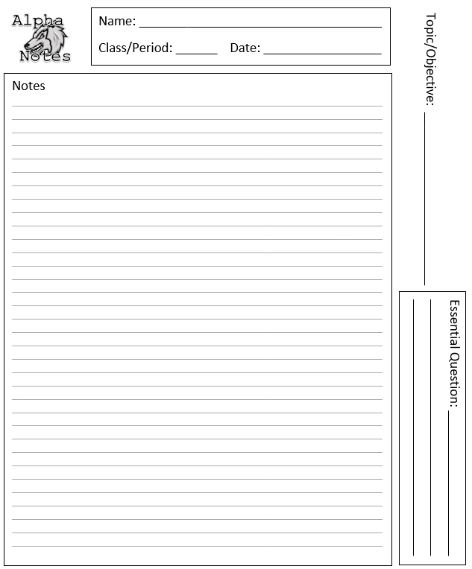
Identification Section
Includes the information that tells you what content these notes contain.
This section is completed when you write your notes.
Name, Class/Period and Date
Topic/Objective
Essential Question
Page Number Box

Slide 9
Identification Section
Lets practice…
Fill in your Name, Class/Period and Today’s Date
For the Topic/Objective write the title of these notes…
The Purpose of Omega Notes
We saw the first Essential Question a few slides ago. Write this question in the space…
How does organizing and reviewing notes help to remember the content?
Your first Butterfly Notes start on the back of your cover sheet when opened. Put a number 1 in the page number box.

Slide 10
Notes Section
Contains the course content (the stuff you need to remember)
Many students do this section incorrectly, because they just copy from the PowerPoint/Google Slides bullets.
To maximize your note taking, you should read and use ALL of the content, then paraphrase into your own bullets.

Slide 11
Notes Section
Let’s run a simple demonstration…
We’ll divide the class into two groups
Each group will get a version of the same story.
I’ll give you time to read the story and then time to write down some notes.

Slide 12
Notes Section
Ok, time to test your knowledge…
Who’s idea is it to send the children into the woods?
How did Hansel and Gretel return the first time?
What did Hansel and Gretel use the second time they went into the forest?
Why did they get lost?
What was the cottage made of?
What did the witch want to do to Hansel and Gretel?
How did Gretel trick the witch?
What did Hansel and Gretel find in the witch’s cottage?
What did the Stepmother think of Hansel and Gretel returning?

Slide 13
Notes Section
Answers…
Stepmother
Hansel dropped white stones on the way out, and followed them back
Crusty bread pieces
Birds ate the bread crumbs when Hansel and Gretel walked away
Chocolate, gingerbread, cookies and candy
Fatten them up, and eat them
Smeared butter on her glasses, and used a chicken bone
A chocolate egg filled with gold coins
Nothing, she was dead when they returned

Slide 14
Why Should I Complete My Notes at Home, Before Class Discussions?
Mr. Kapa will not be lingering on the slides long enough for you to copy everything down.
Mr. Kapa will be telling stories and anecdotes about the content, that could be hints about test questions.
Mr. Kapa will be drawing diagrams on the board to help explain, and these might not be in the notes.
Students might ask questions that Mr. Kapa answers in the moment. These answers might improve the notes, and end up on the tests.

Slide 15
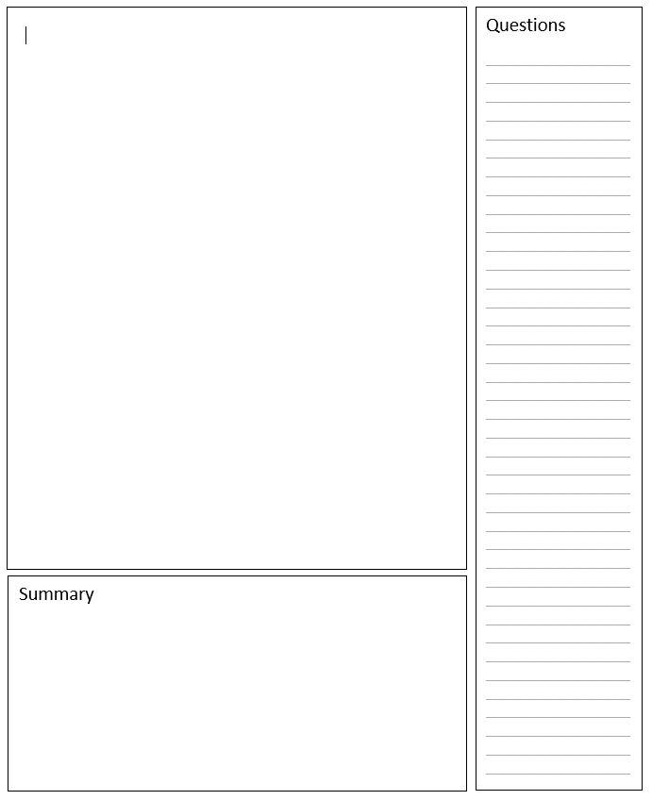
Questions Section
Here is where you will record any questions you have during your note taking.
You can also write questions during lecture, this can remind you to focus on certain concepts when you review.
This section can be used to help you review for quizzes and tests.

Slide 16
Questions Section
Your questions should be positioned across from the content in the notes that is confusing you.
Example:
Confusing material
Question about material
Corresponding question 1
If the confusing material or content is here in the notes…
Corresponding question 2
If the confusing material or content is lower in the notes…

Slide 17
Questions Section
You can use the questions section to help you review by hiding the Notes Section, and trying to answer the questions from memory.
The Butterfly Format will allow you to hide the other half and look at the different sections independently.
Corresponding question 1
Corresponding question 2

Slide 18
Questions Section
Costa Questioning Technique
Costa Level 1 – a simple question that can be answered with limited information.
Write a level 1 Costa Question in the question section.
Costa Level 2 – a more complex question that requires you to find information in multiple places. Basically its like having two level 1 Costa questions in one.
Write a level 2 Costa Question in the question section.
Costa Level 3 – These are broad, open-ended questions. They take more to explain, and often have many different correct answers.
Write a level 3 Costa Question in the question section.

Slide 19
Processing Section
This section is for adding content and ideas that are not necessarily in the notes.
When do you put stuff here…
This section can be done when you’re writing the notes initially. (diagrams, graphs, tables, etc.)
During lecture if the instructor says/draws something not in the notes
During any of your review/revisit times, to add to the content

Slide 20
Processing Section
Let’s do some practice…
Using the upper half of the Processing Box, draw the Ebbinghaus Curve of Forgetting… From Memory… Go!
Do you feel that you have forgotten what you just learned?
Let’s revisit the curve, then redraw the curve on the bottom half of the box using this image…

Slide 21
Summary Section
This section is done during the 2nd or 3rd revisit.
You will want to summarize each page, not just the end of the notes. (That means, when notes are checked for a grade, Mr. Kapa will look EVERY Summary box to be full)
Go back through these notes and write a summary for every page you created.

Slide 22
Mastery Questions
What are the sections of the Alpha Notes Format?
Compare and contrast the material that you would put in the notes section versus the processing section.
Discuss why it is important to complete your notes before you go over the content in class.

