Slide 1
Organic Chemistry and Biomolecules

Slide 2
TEKS
B.9A compare the structures and functions of different types of biomolecules, including carbohydrates, lipids, proteins, and nucleic acids

Slide 3
Vocabulary
Organic Chemistry
Organic
Valence Electron
Monomer
Polymer
Dehydration Synthesis
Hydrolysis
Biomolecules
Carbohydrate
Protein
Nucleic Acid
Lipid
Saturated
Unsaturated
Monosaccharide
Polysaccharide
Amino Acid
Nucleotide
Nitrogenous Base
Phosphate group

Slide 4
Prerequisite Questions
What is a covalent bond?
What are valence electrons?
Why do scientists say that life on Earth is carbon based?

Slide 5
Essential Question
How are structure and function connected in the 4 biomolecules?

Slide 6
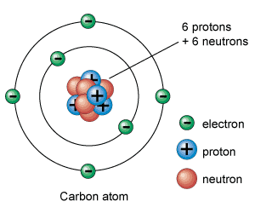
Organic Chemistry
Organic chemistry is study of molecules that contain Carbon.
Valence electrons are the outer most electrons used in bonding.
Carbon is very versatile.
It has 4 valence electrons, so it can form 4 covalent bonds

Slide 7
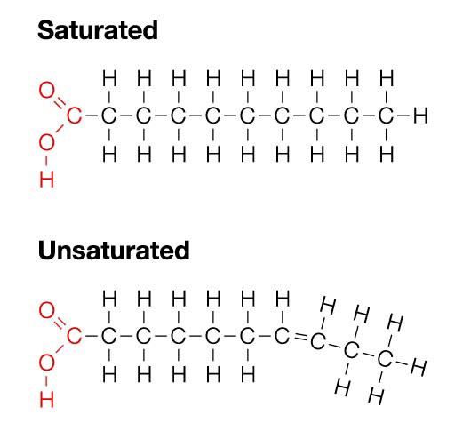
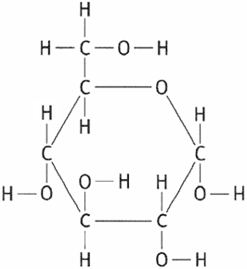
Organic Chemistry
Carbon can form long chains by covalently bonding to itself.
Carbon readily bonds with other elements like H, O, N, P and S
Glucose

Slide 8
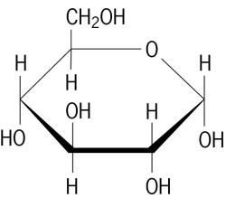
Organic Chemistry - Monomers
A Monomer is a small molecule that is repeated over and over in a larger molecule
Carbohydrates, Proteins and Nucleic Acids have monomers
Ex: Monosaccharide (Glucose)

Slide 9
Organic Chemistry - Polymers
A Polymer is a large molecule made up of many smaller monomers.
Carbohydrates, Proteins and Nucleic Acids also have a polymer structure that is made up of their monomers.
Ex: Polysaccharide (Cellulose)

Slide 10
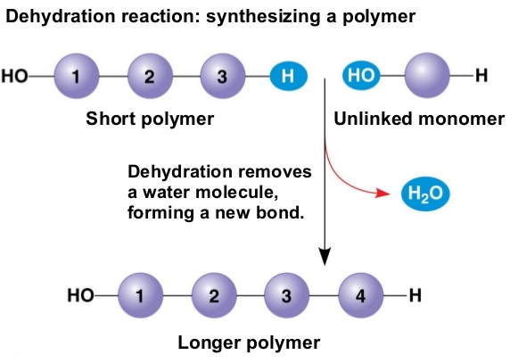
Organic Chemistry – Dehydration Synthesis
The process of Dehydration Synthesis connects monomers together to make polymers and gives off a water molecule in the process.

Slide 11
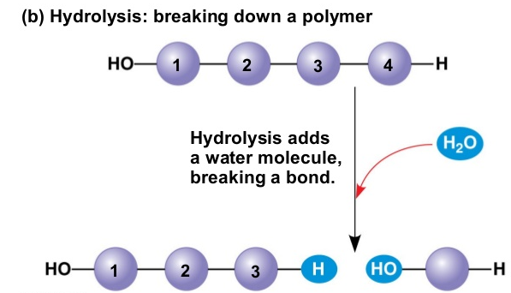
Organic Chemistry – Hydrolysis
The process of Hydrolysis separates monomers from polymers and breaks up a water molecule in the process.

Slide 12
Carbohydrates
Elements: C, H, O (C:O ratio is very close to 1:1) | Major biological use: Short term (quick) energy [4 Kcal/gram] Other biological uses: Structural, Cell identification
Does it have Monomer/Polymer structure: Yes Monomer name – Monosaccharide Polymer name – Polysaccharide | Examples: Monosaccharides: Glucose, Fructose, Maltose, Galactose Polysaccharides: Sucrose, Cellulose, Glycogen, Chitin (HELPFUL TIP: carbohydrates often end in –ose)

Slide 13
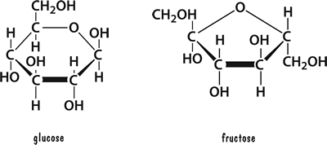
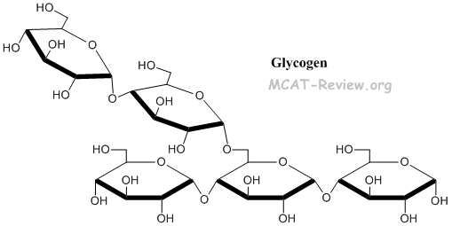
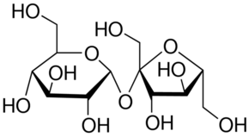
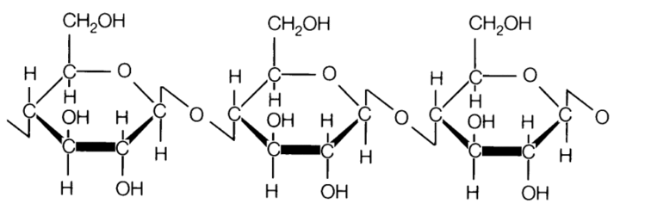
Carbohydrate Images
Monosaccharide (Ex: Glucose and Fructose)
Polysaccharide
(Ex: Sucrose, Cellulose and Glygocen)

Slide 14
Proteins
Elements: C, H, O , N | Major biological use: Enzymes Other biological uses: Structural, Cell identification
Does it have Monomer/Polymer structure: Yes Monomer name – Amino Acid (20 different) Polymer name – Polypeptide/Protein | Examples: Enzymes (Sucrase, Amylase, Lactase), Protein channels, Antibodies, Insulin, Actin, Myosin, Tubulin (HELPFUL TIP: enzymes often end in –ase)

Slide 15
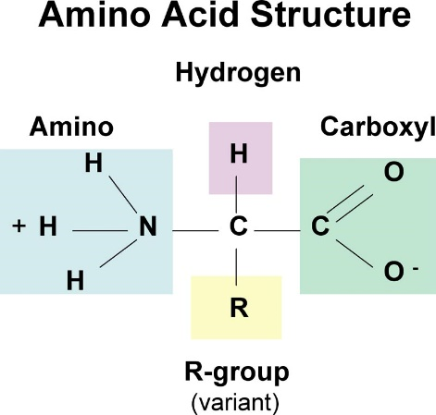
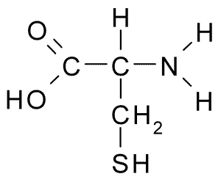
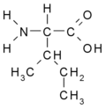
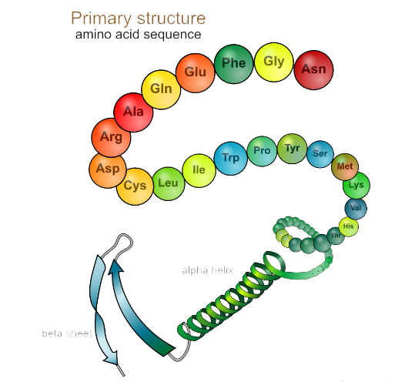
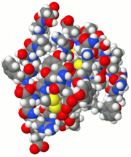
Protein Images
Amino Acid (Ex: general Cystine and Isoleucine )
Polypeptide/Protein (Ex: Polypeptide General and Insulin)

Slide 16
Nucleic Acids
Elements: C, H, O , N, P | Major biological use: Storing Genetic Information Other biological uses: Building proteins
Does it have Monomer/Polymer structure: Yes Monomer name – Nucleotide Polymer name – Nucleic Acid/Polynucleotide | Examples: DNA (Double Stranded, contains A, C, G and T) RNA (Single Stranded, contains A, C, G and U)

Slide 17
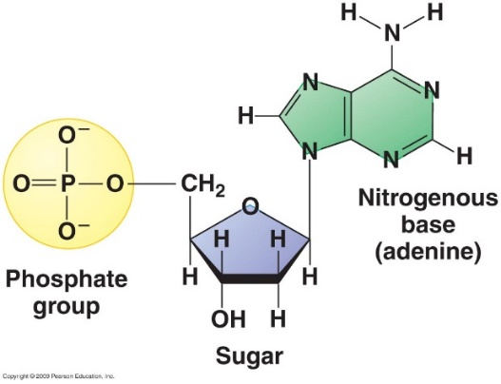
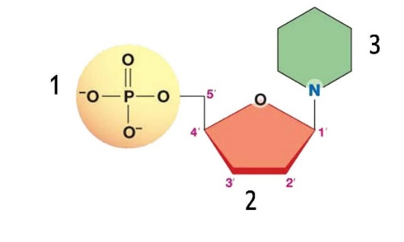
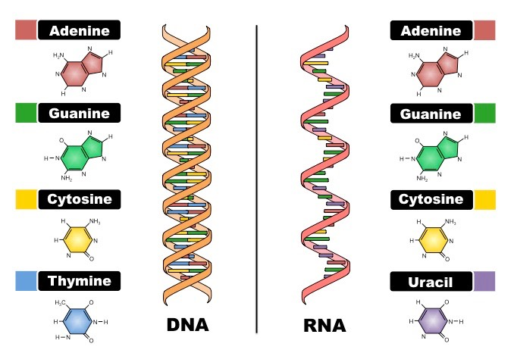
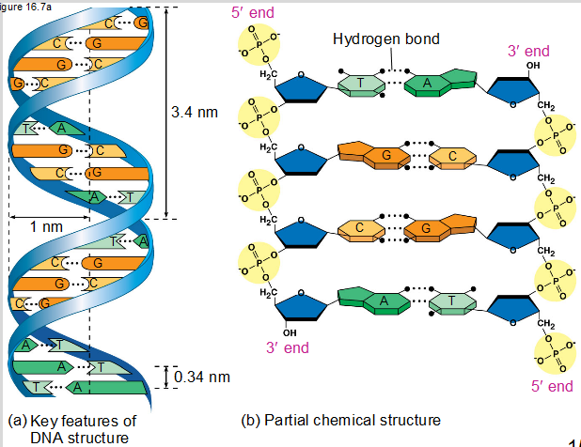
Nucleic Acid Images
Nucleotide (Ex: General and Adenosine)
1 – Phosphate group
2 – Sugar
3 – Nitrogenous Base
Polynucleotide/Nucleic Acid (Ex: DNA and RNA)

Slide 18
Lipids
Elements: C, H and sometimes O (C:O ratio is NOT close to 1:1) | Major biological use: Long term (slow) energy [9 Kcal/gram] Other biological uses: Insulation, Lubrication, Cell boundaries, Signals
Does it have Monomer/Polymer structure: NO! | Examples: Saturated Fats, Unsaturated Fats, Steroids, Phospholipids

Slide 19
Saturated vs. Unsaturated Fats
Saturated Fats have all single bonds between the carbons.
The carbons are saturated with hydrogens.
Unsaturated Fats have at least one double bond between carbons.
Hydrogens have to be removed to make the double bonds

Slide 20
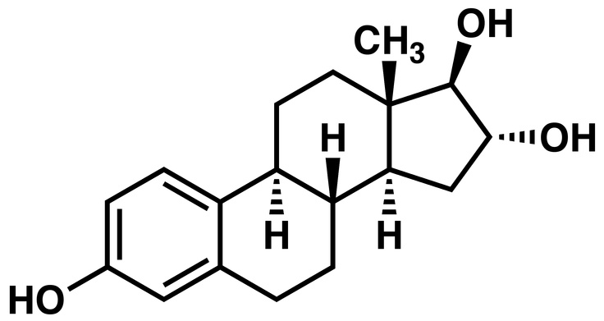
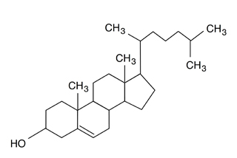
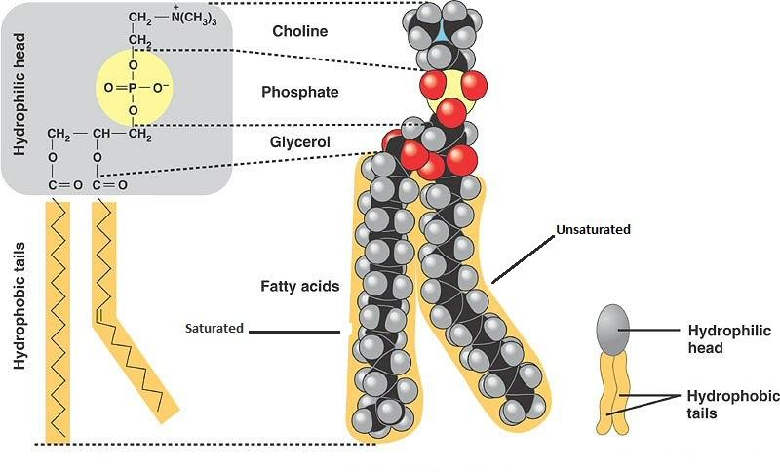
Lipid Images
Steroids/Sterols (Ex: Estrogen and Cholesterol )
Phospholipid Saturated Fat Unsaturated Fat

Slide 21
Concept Mastery Questions
How does dehydration synthesis create new molecules?
What molecule is released when a polymer is created with dehydration synthesis?
How are lipids different from the other 3 biomolecules?
What biomolecules are a good source of energy? Explain…

