Slide 1
Organizing & Displaying Data

Slide 2
TEKS and S.E.s
B.2E Analyze data to formulate reasonable explanations, communicate valid conclusions supported by the data, and predict trends.
B.2G analyze, evaluate, make inferences, and predict trends from data
8.2D Construct tables, using repeated trials and means to organize data and identify patterns.

Slide 3
Vocabulary
Independent variable
Dependent variable
Control variable
Qualitative
Quantitative

Slide 4
Prerequisite Questions
What is a variable?
What is data?

Slide 5
Our investigations provide us with data
We try to organize that data in a way that will highlight relationships among our investigation’s variables
Variables can be: independent, dependent or controlled

Slide 6
Essential Question#1:
What is the difference between the independent and dependent variables?

Slide 7
Independent Variables
If you ask “What is changing/being compared in this experiment?”, then you are looking at the independent variables.
An independent variable is something that is manipulated during the experiment.
Examples:
Baking the same cupcake batter at different temperatures to determine which causes the best cake texture.
Comparing the insulation material of coffee cups to see which one is better at keeping coffee warm.

Slide 8
Dependent Variables
If you ask “What is being observed/measured in this experiment?”, then you are looking at the dependent variables.
A dependent variable is something that is responding or changing because of the independent variables during the experiment.
Examples:
Cupcake texture at a low temperature is too runny, while the texture at a very high temperature can be hard and dry.
Coffee temperature cools very quickly when put in a thin glass mug but stays hot longer if you use a thick ceramic mug.

Slide 9
Control Variables
If you ask “What is being kept the same in this experiment?”, then you are looking at the control variables.
A good experiment will only test ONE independent variable at a time.
That means every other variable in the experiment must be the same for each trial.
Examples:
The same cupcake batter, oven, pan, etc. was used each time. The only difference in variables was the temperatures.
The same coffee at the same starting temperature for the same amount of time were used in different cups. This means only the change is temperature was being tested.

Slide 10
Types of Data
There are two (2) types of data that will be collected in labs
Qualitative Data
Quantitative Data
Qualitative data is based on the quality of the material.
These will be measured with the 5 senses
Quantitative data is based on the quantity of the material
These will be represented by numbers from measuring, massing or counting

Slide 11
Organizing Data
Month of the Year | Average Temperature
January | 50° F
February | 54° F
March | 61° F
April | 68° F
May | 75° F
June | 82° F
July | 84° F
August | 84° F
September | 79° F
October | 70° F
November | 59° F
December | 52° F
Data should always be organized to see patterns. (Tables, groups, lists, etc.)
The table to the left shows the average temperatures for the months of the year.
It is made up of hundreds temperatures for all of the individual days.
By organizing it by monthly averages, scietists can see the trends much easier.

Slide 12
Essential Question#2:
What conditions are used to determine the appropriate type of graph?

Slide 13
Types of Graphs
In this lab classroom, we will use 3 main types of graphs:
Line Graph
Bar Graph
Pie Chart
Each type of graph has a specific best use based on the data that was collected.

Slide 14
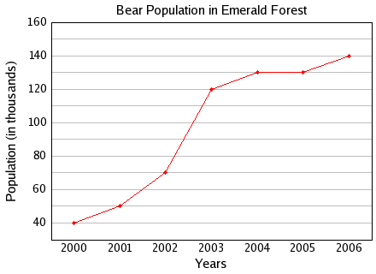
Line Graph
Line graphs show how a data set is changing over some dimension (time, distance, temperature, etc.) so the points are connected.
X-axis shows the independent variable
Y-axis shows the dependent variable

Slide 15
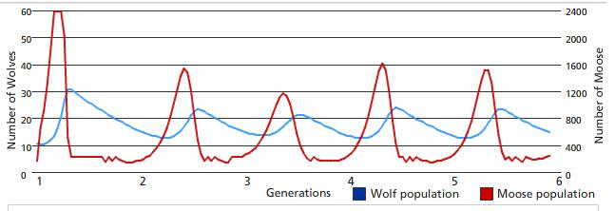
Line Graph
Sometimes a scientist may need to compare multiple data sets at once, so the graph will show multiple lines

Slide 16
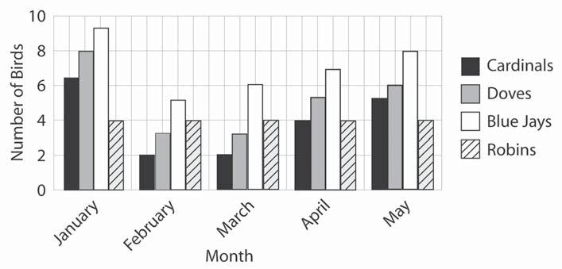
Bar Graph
Bar graphs show comparison between different sets of data
Typically it’s not the act of changing that important, but the numbers at different times

Slide 17
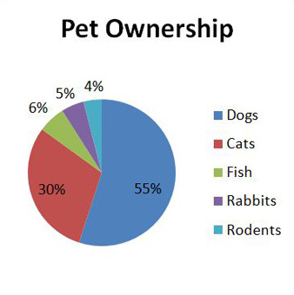
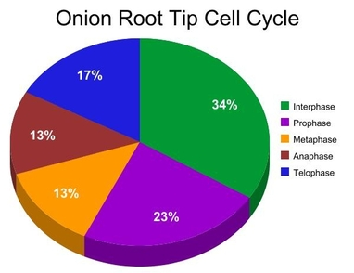
Pie Chart
Pie charts show what percentage of the whole the different data sets belong to.
Pie charts do not show changes over time.

Slide 18
Concept Mastery Questions
What is the difference between independent and dependent variables?
Why should you test only one unknown at a time?
When do you want to display your data as a line graph? Bar graph? Pie chart?

