Slide 1
Replication and the Cell Cycle
(Cover TITLE of Foldable)

Slide 2
TEKS
5A Describe the stages of the cell cycle, including deoxyribonucleic acid (DNA) replication and mitosis, and the importance of the cell cycle to the growth of organisms.

Slide 3
Vocabulary
Cell cycle
Interphase
G₀
G₁
S
G₂
Mitosis
Prophase
Centriole
Spindle Fiber
Metaphase
Anaphase
Telophase
Cytokinesis
Chromosome
Chromatid
Chromatin
Cancer

Slide 4
Prerequisite Questions
What are the monomers of DNA/RNA?
Where is DNA located in eukaryotic cells?

Slide 5
Preparing the Manipulative
You will need 4 sheets of blank paper
Stagger the sheets about 1 cm apart
Fold the stack in half putting the “top” of the folded stack about 1 cm from the “bottom” flap (See Diagram on next slide)

Slide 6
Stagger the 4 sheets of Paper
Stack the 4 sheets of paper
Slide each piece of paper so that the bottom edges are about 1cm from each other

Slide 7
Fold the stacked paper
Fold the entire stack so that the top edge is the same distance above the bottom of the top sheet of paper.
If done correctly, you should have 8 flaps including the cover
Top Edge
Top Edge

Slide 8
Your foldable should be labeled like this… (color choice is up to you)
Replication & The Cell Cycle
Replication
Cell Cycle
I Interphase
P Prophase
MITOSIS
M Metaphase
A Anaphase
TC Telophase and Cytokinesis

Slide 9
Essential Question 1 (Replication flap)
Why is DNA replication an essential process to the cell cycle?

Slide 10
Vocabulary (Replication flap)
Replication – the process of making two new and IDENTICAL strands of DNA from an original DNA strand
Semiconservative – ½ of Replicated DNA is old and ½ is new
Complementary – opposite DNA strand follows base pairing rule

Slide 11
Replication (Replication flap)
Base pairing: A T (Adenine pairs with Thymine) G C (Guanine pairs with Cytosine)

Slide 12
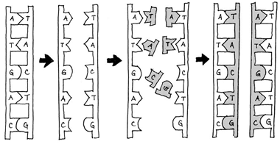
Replication (Replication flap)
Steps:
1. DNA is “unzipped” by Helicase
2. DNA base pairs are matched by DNA Polymerase

Slide 13
Essential Question 2 (Cell cycle flap)
What is important about each phase of the cell cycle?

Slide 14
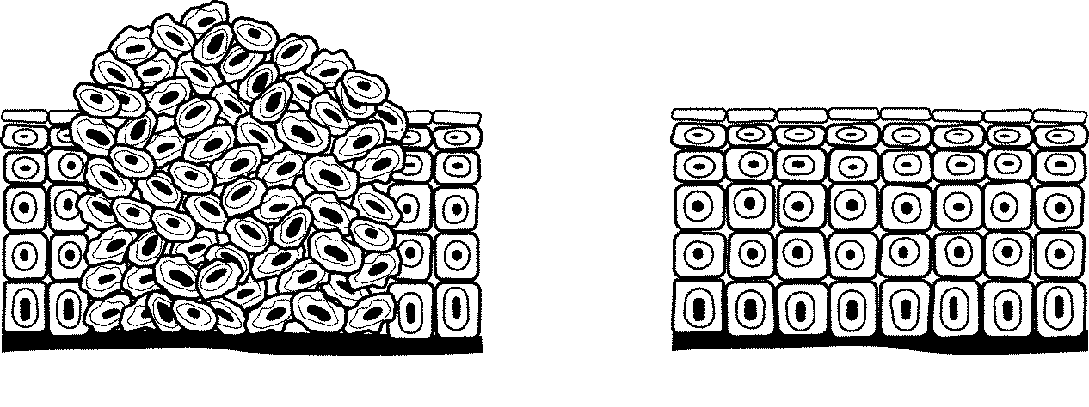
Cell Cycle (Cell cycle flap)
Made up of 2 stages INTERPHASE and MITOSIS
Reasons for cell cycle:
1) Smaller Cells are more efficient
2) Repair AND Replace Damaged Tissues
3) Growth of Organisms
When the cell cycle goes “crazy” it causes CANCER
Cancer – when cells divide uncontrollably
Cancerous Tumor
cell growth
Normal
cell growth

Slide 15
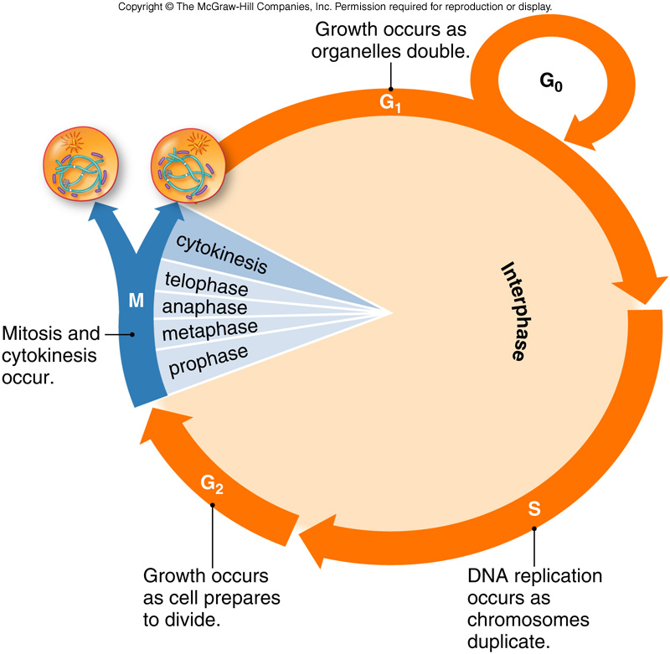
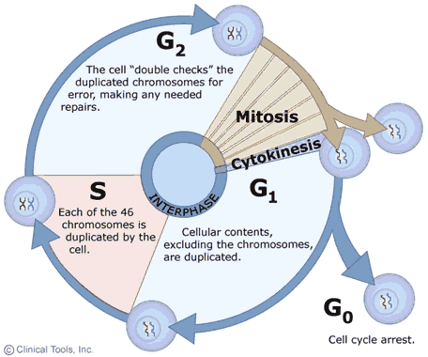
Cell Cycle Picture (Cell cycle flap)

Slide 16
DNA Forms (Cell Cycle Flap)
Chromatin – when DNA is NOT tightly wound (not condensed).
It looks like “spaghetti” in most drawings at this time
During interphase
Easy to access genes
Chromosome – DNA is tightly wound up to make it easier to move around during Mitosis

Slide 17
Chromosome Picture (Cell Cycle flap)
Sister chromatids are
IDENTICAL pieces of DNA
These are created in S phase of interphase during replication of DNA
Centromere
Held together by the Kinetochore protein
Sister Chromatids

Slide 18
Interphase Portion (Interphase flap) of Cell cycle Picture

Slide 19
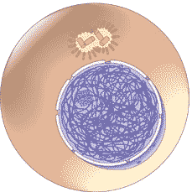
Interphase (Interphase flap)
Centrioles
Longest stage of Cell cycle
G₀ – cell is “resting”
G₁ – basic growth of cell
S – Replication (Synthesis) of DNA
– DNA gets repaired here when needed
G₂ – Final preparation stage before Mitosis
Nucleus
Chromatin

Slide 20
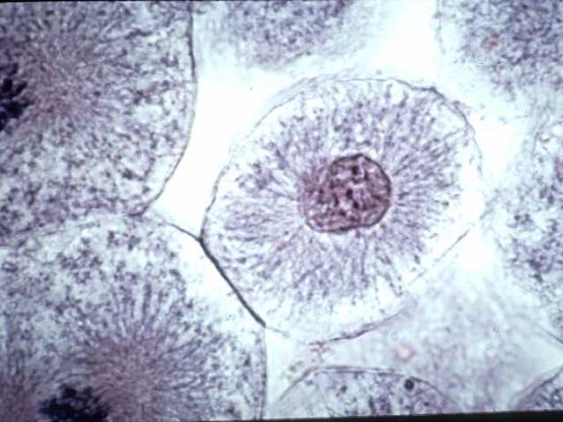
Microscope Interphase

Slide 21
Mitosis (On top part of Prophase flap)
Mitosis is the actual division of the NUCLEAR MATERIAL (DNA)
The Nucleus of the cell disappears and the DNA is divided into two identical parts after it is Replicated in S phase
This is the ACTUAL cell division time

Slide 22
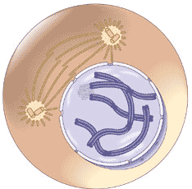
Prophase (bottom part of Prophase flap)
Chromatin condenses (turns into) Chromosomes
Centrioles are copied and start to move
First phase we see CHROMOSOMES
Nuclear Envelope Disappears
Spindle Fibers
Centrioles

Slide 23
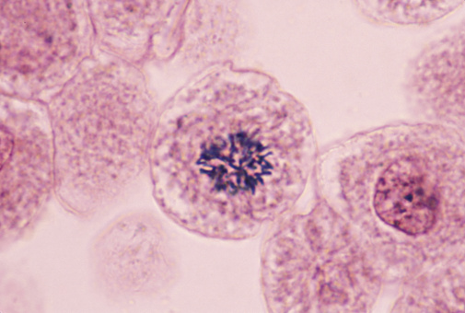
Microscope Prophase

Slide 24
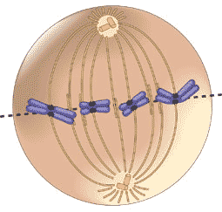
Metaphase (Metaphase flap)
Centrioles attach spindle fibers to chromosomes
Chromosomes are lined up in middle at the Metaphase Plate
Spindle Fibers
Chromosome
Centrioles
Metaphase plate

Slide 25
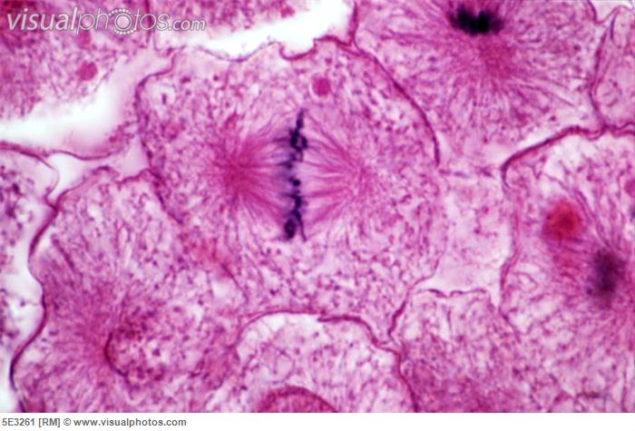
Microscope Metaphase

Slide 26
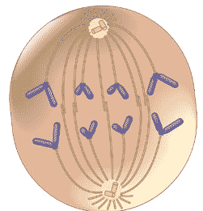
Anaphase (Anaphase flap)
Centrioles use spindle fibers to pull Sister Chromatids apart (Chromsomes are pulled apart)
Sister Chromatids are pulled toward the centrioles at the “Poles”
Centrioles
Spindle Fibers
Chromatids (sister)

Slide 27
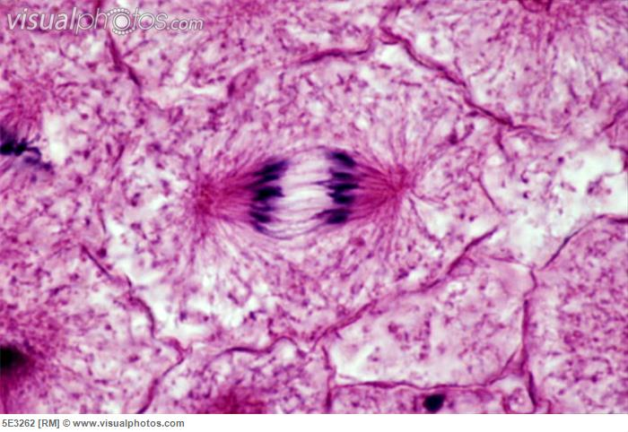
Microscope Anaphase

Slide 28
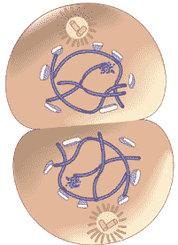
Telophase and Cytokinesis (Telophase and cytokinesis flap)
Telophase:
Chromosomes start to unravel back into Chromatin
A NEW nuclear envelope is created around the new chromatin
Cytokinesis - The cell starts to pinch in half making two new cells (cleavage)
Each cell now goes back into Interphase and start all over again
Centrioles

Slide 29
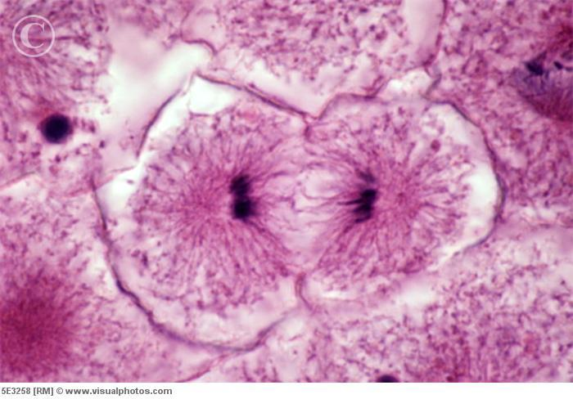
Microscope Telophase (and Cytokinesis starting)

Slide 30
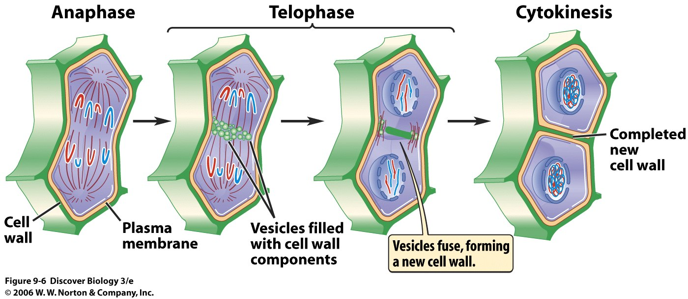
Plant Cell Division (Telophase and cytokinesis flap)
A plant cell divides by lengthening and creating a new cell wall in the middle to separate the two cells

Slide 31
Cell Cycle Picture…Again

Slide 32
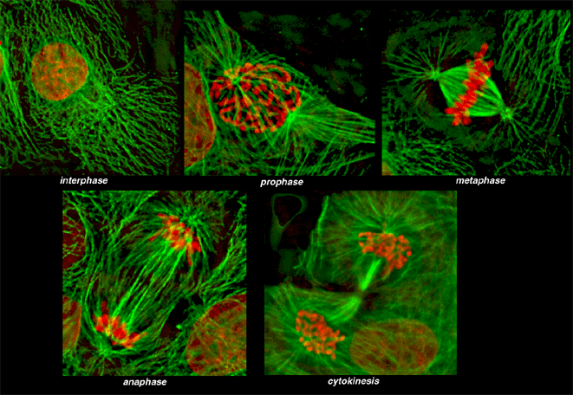
Cell Cycle Image (Animal cell)

Slide 33
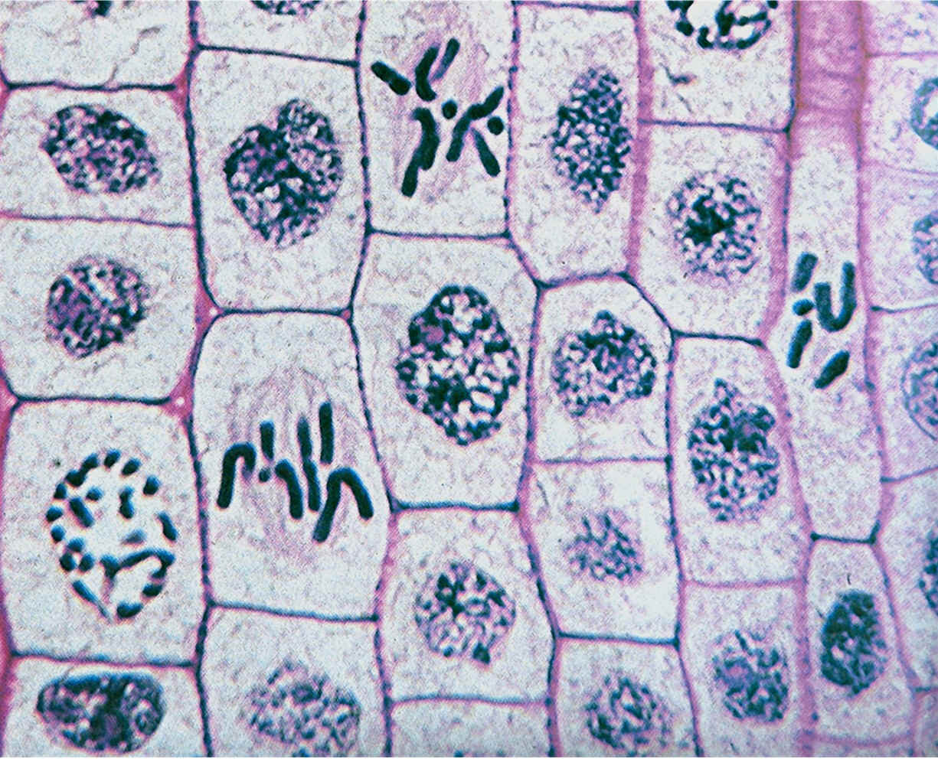
Cell Cycle Image (Plant cell)

Slide 34
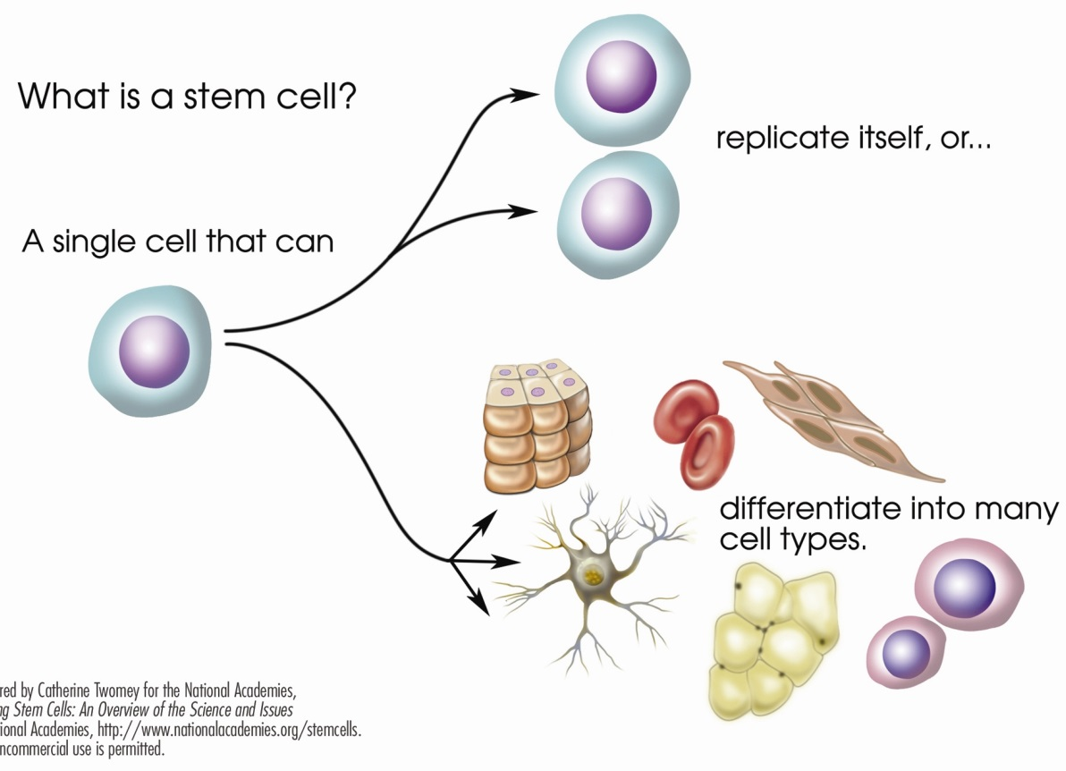
Cell Differentiation and Specialization (On the back of the foldable)
As cells are being created in mitosis, the DNA instructions are being accessed
Specialized proteins are made to turn cells into one of thousands of different kinds
DNA is the genetic code for the making of proteins used for structure and enzymatic function

