Slide 1
Transport and Tonicity Omega Notes

Slide 2
TEKS
(4) Science concepts. The student knows that cells are the basic structures of all living things with specialized parts that perform specific functions and that viruses are different from cells. The student is expected to:
(B) investigate and explain cellular processes, including homeostasis, energy conversions, transport of molecules, and synthesis of new molecules

Slide 3
Vocabulary
Solute
Solvent
Solution
Hydrophobic
Hydrophilic
Cell/Plasma Membrane
Phospholipid bi-layer
Concentration gradient
Permeable
Selectively permeable
Equilibrium
Diffusion (Simple Diffusion)
Facilitated diffusion
Osmosis
Aquaporins (Honors)
Active transport
Hypertonic
Hypotonic
Isotonic
Cytolysis (Honors)
Turgor (Honors)
Plasmolysis (Honors)

Slide 4
Essential Question
How do concentration of solute molecules affect the movement of water?

Slide 5
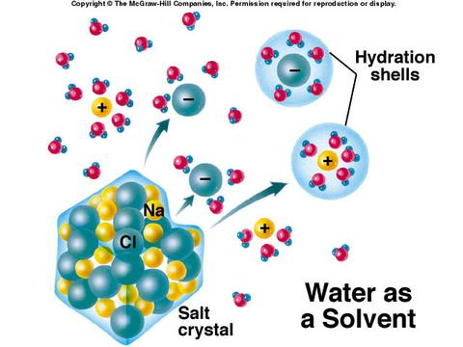
Vocabulary (Include all vocabulary in Vocab Sheets)
Solute – a molecule that is being dissolved
Ex: salt or sugar will dissolve in water
NOTICE: look how the water molecules orient themselves to the + or – solute ions
Na⁺ (Sodium Ion)
Cl⁻ (Chlorine Ion)

Slide 6
Solvent – a molecule that can dissolve something
Ex: Water (the universal solvent)

Slide 7
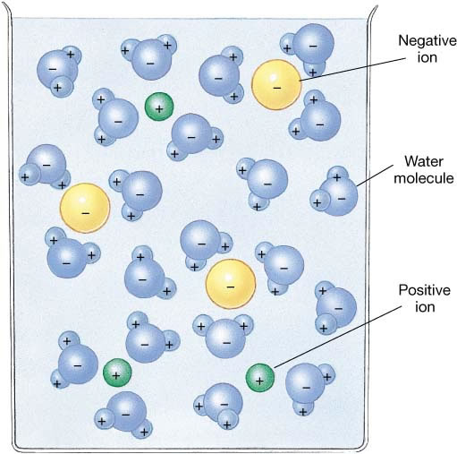
Solution – made up of solvent and solutes
Solute
Solute
Water
Solute

Slide 8
Hydrophobic – molecule that does NOT want to be around water ** NONPOLAR (ex: oil)
HATES WATER
Hydrophilic – molecule that wants to be around water -** POLAR (ex: sugar, salts, other waters)
LOVES WATER

Slide 9
Phospholipids
Phosphate Head
HYDROPHILIC “Loves Water”
Draw this diagram in your notes
HYDROPHOBIC “Hates Water”
Lipid Tails

Slide 10
Cell (or Plasma) Membrane
Phospholipid Bilayers – lipid layers creates a water proof boundary for the cells (Purple Area)

Slide 11
Cell (or Plasma) Membrane
* Cell membranes control what enters or leaves the cells

Slide 12
Concentration Gradient
Concentration Gradient – the difference between molecules (green hexagons) on opposite sides of the membrane

Slide 13
Notice the difference between HIGH concentration and LOW concentration
High Concentration
Low Concentration

Slide 14
Permeable
Permeable – when molecules can cross a membrane

Slide 15
Selectively Permeable
Selectively Permeable – when certain molecules are allowed to cross a membrane

Slide 16
IF they can, molecules will ALWAYS try to equal out on both sides

Slide 17
Equilibrium
Equilibrium – when solute amounts are EQUAL everywhere (usually referring to both sides of a membrane)

Slide 18
Cellular Transport
These notes are in your Cellular Transport Foldable – You do not need to include them in your Omega Notes

Slide 19
Picture for Simple Diffusion
HIGH Concentration
LOW Concentration

Slide 20
Simple Diffusion
Diffusion - ALWAYS moves solutes from High Concentration → Low Concentration (Down the concentration gradient)
Simple diffusion allows molecules to move through the phospholipid bilayer without needing help.
Molecules must be Small, Nonpolar and Not have a charge
Diffusion NEVER needs energy (ATP)

Slide 21
Simple Diffusion
Examples:
1) perfume/cologne will diffuse through the entire room when someone sprays it.
2) if the room catches on fire, the students will diffuse from inside (High concentration) to outside (Low concentration) of students
3) a child going down a slide is like moving down the concentration gradient.

Slide 22
Picture for Facilitated Diffusion
HIGH Concentration
LOW Concentration

Slide 23
Facilitated Diffusion
Facilitated Diffusion ALWAYS moves from High Concentration → Low Concentration (Down the concentration gradient)
Facilitated diffusion - REQUIRES a helper transport protein to get solute molecules across the phospholipid bilayer.
Facilitated Diffusion NEVER needs energy (ATP)

Slide 24
Facilitated Diffusion
The solute molecules are either Too BIG or Too HYDROPHILIC to cross the lipid area of the phospholipid bilayer
Transport proteins act as a tunnel that solutes travel through.

Slide 25
Picture for Osmosis
HIGH Concentration
LOW Concentration

Slide 26
Osmosis
Osmosis ALWAYS moves from High Concentration → Low Concentration (Down the concentration gradient)
Osmosis REQUIRES a helper transport protein to get WATER molecules ( ) across the phospholipid bilayer.
Osmosis NEVER needs energy (ATP)

Slide 27
Osmosis
Osmosis – Movement of water across a membrane
Water molecules will never be able to easily cross the lipid area of the phospholipid bilayer, but ALL CELLS NEED WATER
Aquaporin is the transport protein that acts as a tunnel that solutes travel through.

Slide 28
2 Pictures for Active Transport
NOTICE: There are two pictures for Active Transport. Put one picture above the other
Picture 1
Picture 2

Slide 29
Step 1 for Active Transport
LOW Concentration
ATP
ADP
HIGH Concentration

Slide 30
Step 2 for Active Transport
LOW Concentration
HIGH Concentration

Slide 31
Active Transport
Active Transport ALWAYS moves from LOW Concentration → HIGH Concentration (AGAINST the concentration gradient)
Active Transport - ALWAYS REQUIRES ENERGY (ATP) and a helper transport protein to get solute molecules across the phospholipid bilayer AGAINST the concentration gradient
Active Transport ALWAYS needs energy (ATP)

Slide 32
Active Transport
Ex: Think of a bouncer at a popular club. When the cell (club) is full, and a solute (person) wants to try and get in, they have to PAY the bouncer to let them “sneak” by. Money would be like the cell paying ATP energy to make the protein channel (bouncer) let the solute (person) in.
Active Transport is the only kind of cell movement that REQUIRES energy to work.

Slide 33
Bulk Transport, Tonic Solutions & Concentration Notes (These are the rest of the notes – Continue your Omega Notes from here)

Slide 34
Bulk Transport (active transport)
Bulk Transport is different than Simple Diffusion, Facilitated Diffusion or Active transport across a membrane.
Bulk Transport involves the folding of the membrane to use vesicles for transport.
Bulk Transport is a kind of active transport, because energy is used to move the vesicle.

Slide 35
Two Kinds of Bulk Transport
Endocytosis – a cell brings materials from outside the cell, into the cell and stores it in a vesicle.
Exocytosis – a cell will store materials in a vesicle, then transport that vesicle to the cell membrane to release the materials out of the cell.

Slide 36
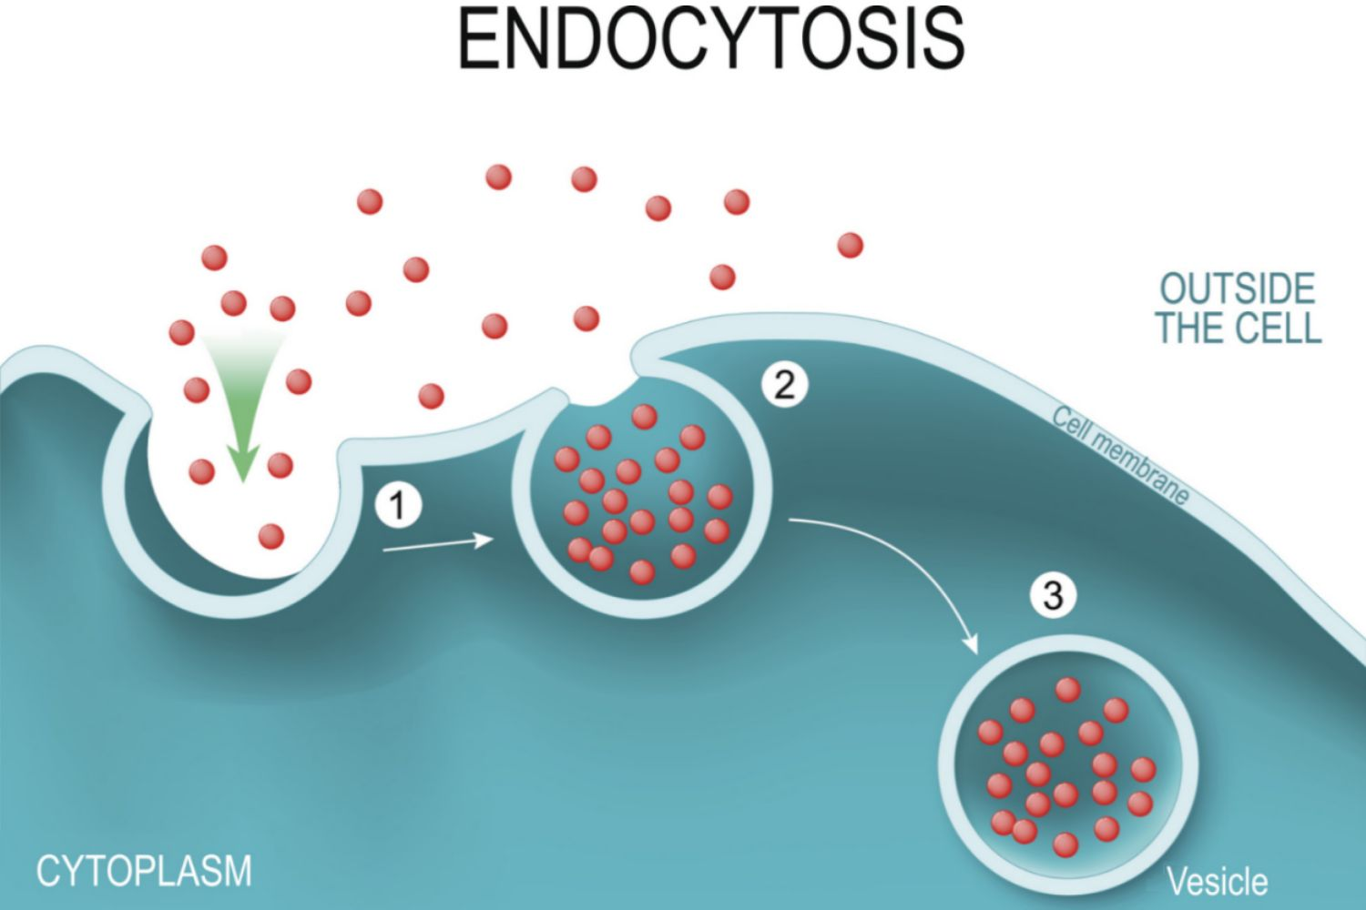
Endocytosis

Slide 37
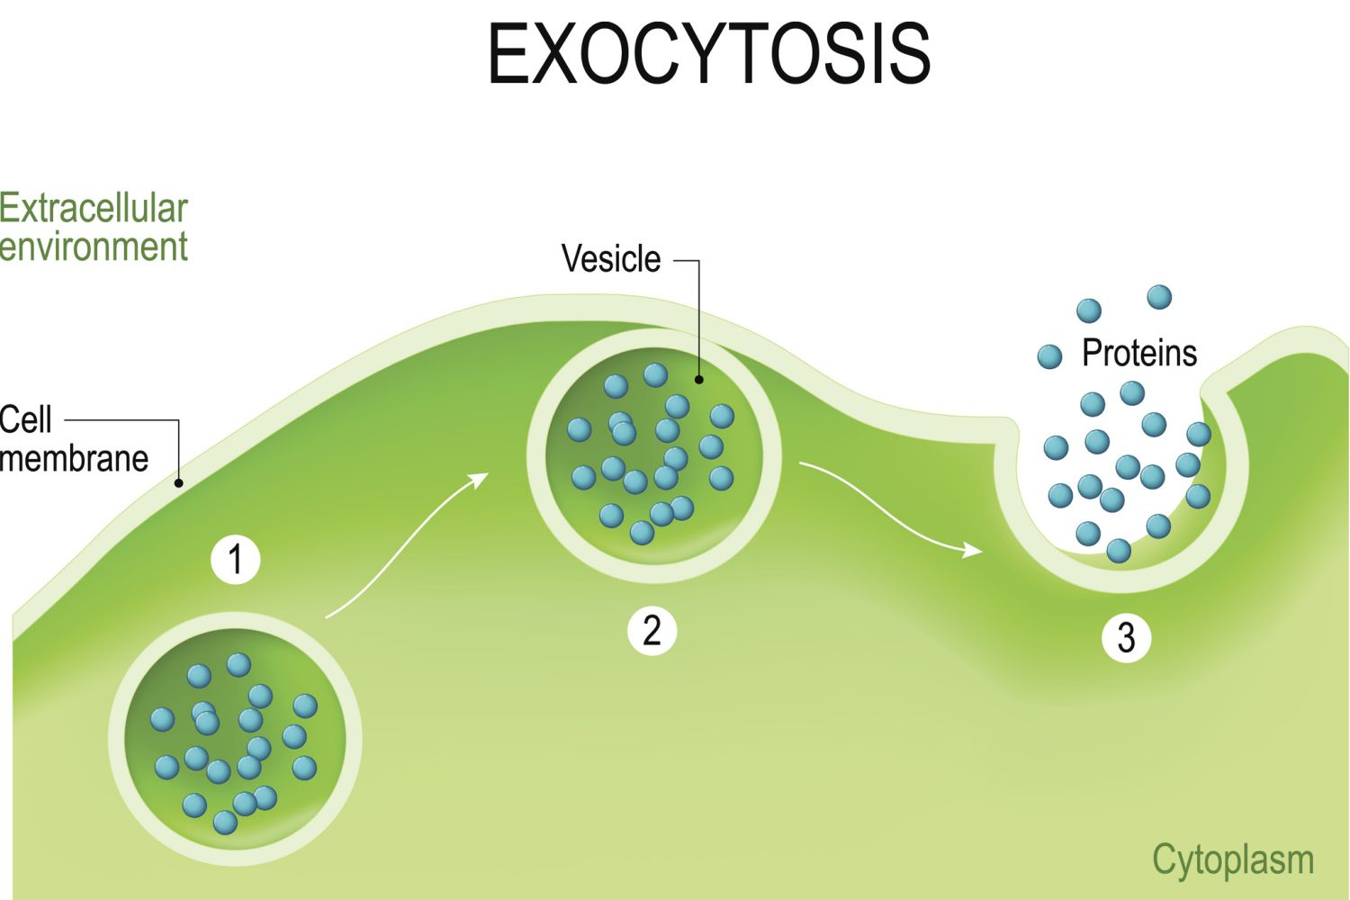

Slide 38
Tonicity Notes Tracking solutes and solvent (water)

Slide 39
Types of osmotic solutions
Hypertonic Solution
Low water concentration (few water molecules) because of more solutes = water moves out & cell shrinks (Plasmolysis)
Isotonic Solution
Equal solutes & water molecules, so equal movement of water into and out of the cell
Hypotonic Solution
High water purity (lots of water molecules) & less solutes = water moves in & cell expands and may burst (Cytolysis)

Slide 40
Hypertonic
Hypertonic means there are MORE solutes and less water in a solution

Slide 41
Isotonic
Isotonic means there are EQUAL amounts of solutes compared to water in a solution

Slide 42
Hypotonic
Hypotonic means there are LESS solutes and more water in a solution

Slide 43
Osmosis (Highlight this statement in your Omega Notes)
Water ALWAYS moves from Hypotonic solutions to Hypertonic Solutions.
HYPERTONIC
HYPOTONIC

Slide 44
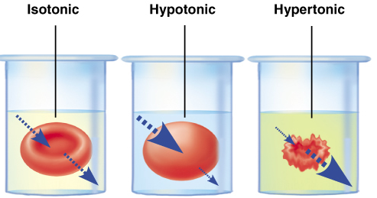
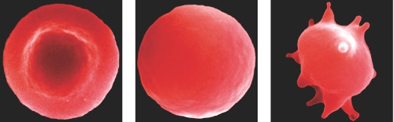
Blood cell examples in tonic solutions

Slide 45
Animal Cell Before and After Images
The solid line is the membrane before, and the dotted line is where the was in the before.
The dotted line is a marker, so you can show a new solid line for change in membrane position.
Animal: Initial (show water movement w/ arrow)
Animal: Final (show change in the cell/membrane)
Solutes
Water leaves the cell
Cell Membrane shrinks

Slide 46
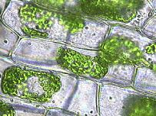
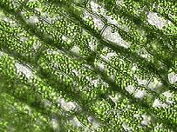
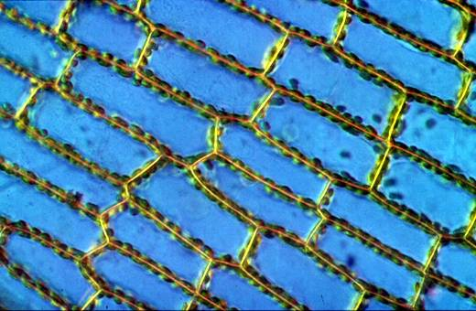
Plant cell examples in tonic solutions
Plant Cells in hypotonic solution
Plant Cells in isotonic solution
Plant Cells in hypertonic solution
Plasmolysis
Flaccid
Turgid

Slide 47
Plant Cell Before and After Images
The solid line is the membrane before, and the dotted line is where the was in the before.
In plant cells the membrane is attached to the cell wall in places.
Plant: Initial (show water movement w/ arrow)
Plant: Final (show change in the cell/membrane/wall)
Solutes
Water leaves the cell
Cell Membrane shrinks

