Slide 1
Viruses

Slide 2
TEKS
Compare the structures of viruses to cells, describe viral reproduction, and describe the role of viruses in causing disease such as Human Immunodeficiency Virus (HIV) and influenza

Slide 3
VOCABULARY
Virus
Capsid
Envelope
Human Immunodeficiency Virus (HIV)
Influenza

Slide 4
Prerequisite questions
What are the eight characteristics which all living things have in common?
What are the 4 organelles/molecular structures that all living things must contain?

Slide 5
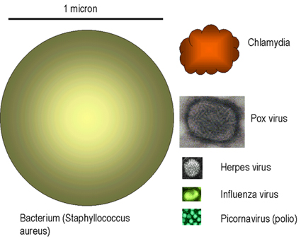
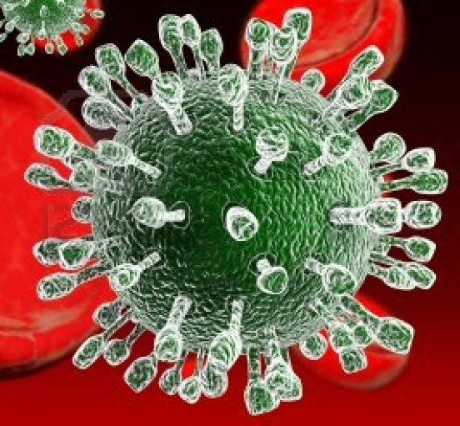
What is a virus?
Are Non-living particles
Composed of nucleic acid in a protein coat
Smaller than any bacteria
Named for disease they cause, or for the organ or tissue they infect

Slide 6
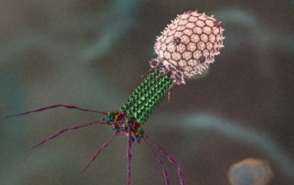
Viruses…are they alive?
They are considered NON LIVING because they:
1. don’t grow
2. don’t develop
3. don’t reproduce
4. don’t carry out respiration
*Viruses DO NOT divide on their own, they are REPLICATED (Copied) in a host cell

Slide 7
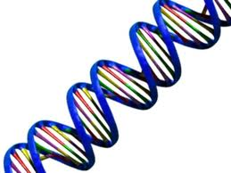
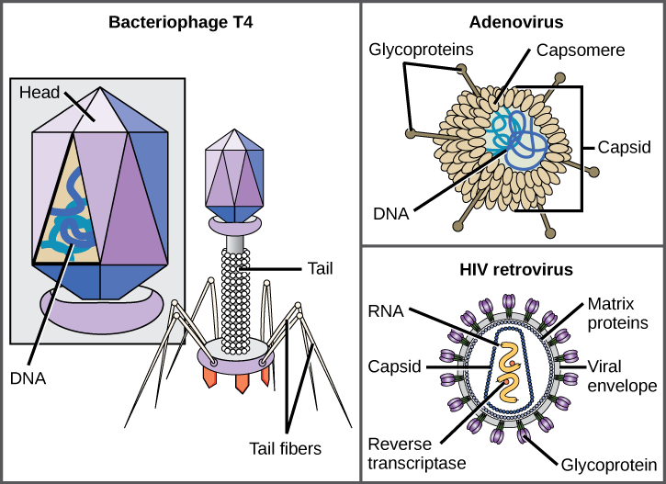
Structures found in all viruses
1. Nucleic acids (either DNA or RNA)
2. Capsid - protein coat that surrounds the nucleic acid

Slide 8
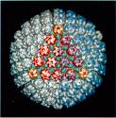
What is that sticking off the capsid?
Projections on some capsids determines what cell can be infected and how the virus infects the cell
Think of them like keys to get through the cell membrane

Slide 9
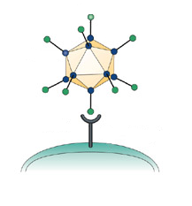
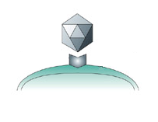
A virus recognizes cells it can infect by matching its surface marker with a receptor site on a cell.
Virus
Surface Markers
Cell
Receptor Sites
This process of protein reception is very similar to the enzyme/substrate complex specificity.

Slide 10
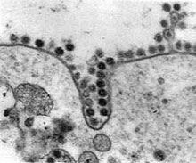
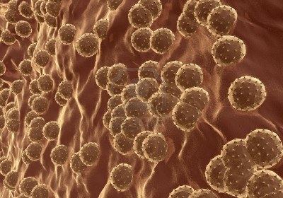
Viral Replication
Remember viruses do NOT reproduce
Viruses require a HOST CELL to replicate (they are built)

Slide 11
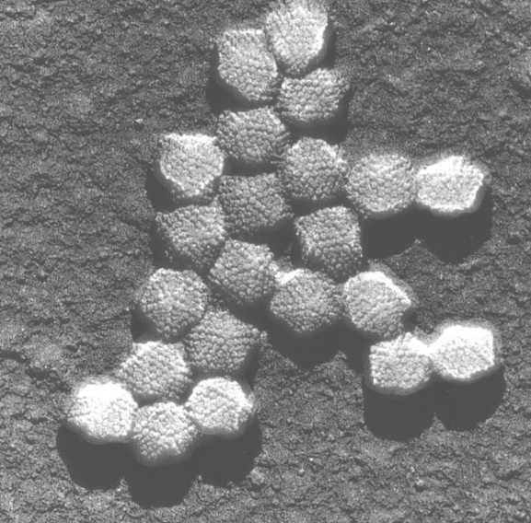
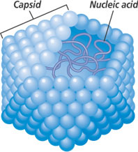
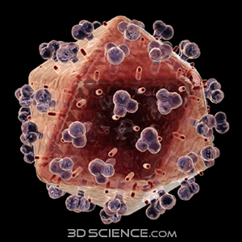
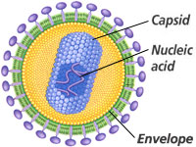
4 Most Common Viral Shapes:
1. Polyhedral
Papilloma virus
causes warts
2. Envelope studded with projections
Influenza (flu)
HIV
Adenovirus

Slide 12
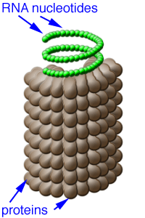
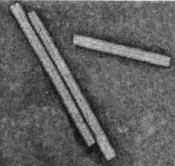
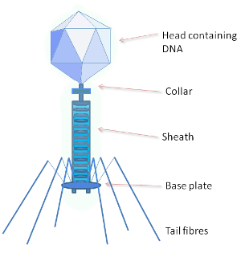
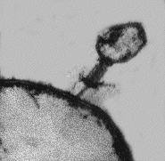
Viral Shapes
3. Helical
tobacco mosaic virus
Plant virus
4. Bacteriophage
polyhedral-shaped head
cylindrical tail
leglike fibers
Only infects BACTERIA
TMV

